Slide 1
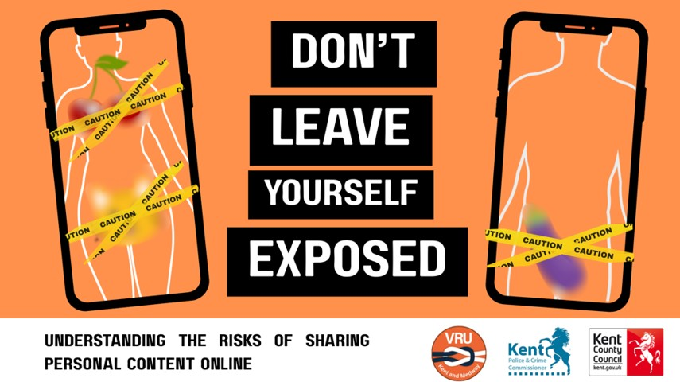
Notes:
Today we’re talking about something really important; how sharing personal content online, and asking others to share it, can have serious consequences.
Today’s session is about protecting yourself and being responsible for how you treat others online. Some of the content may be sensitive or upsetting.
If you need support, please speak to a trusted adult.

Slide 2
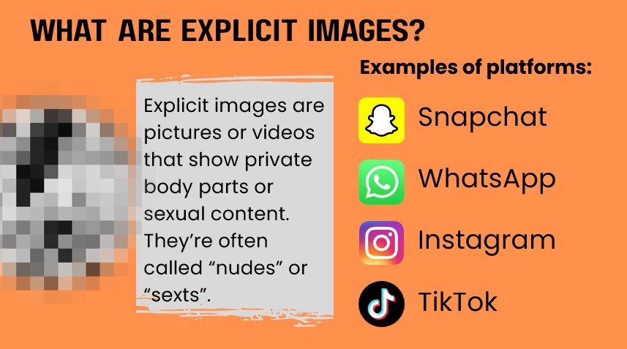
Notes:
Explicit images are pictures or videos that show private body parts or sexual content. These are sometimes called ‘nudes’ or ‘sexts’. They’re often shared through apps like Snapchat, WhatsApp, Instagram, TikTok, and even Discord.
Imagine someone you know gets a message saying ‘Send me something sexy and I’ll delete it straight away.’ That’s how it often starts.
Snapchat messages and photos can disappear after being viewed, which makes people feel it’s safe, but it’s not. Anyone can take a screenshot or use another device to save the image before it disappears, so once it’s sent, you lose control over where it goes.

Slide 3
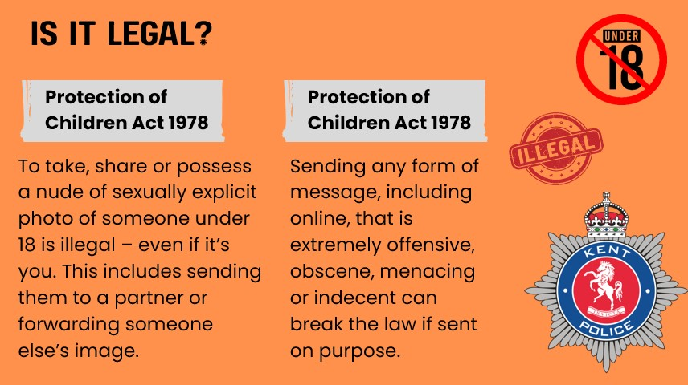
Notes:
It’s against the law to create, share, or possess sexual images of anyone under 18, even if you’re under 18 yourself. This includes:
- Taking explicit images of yourself.
- Sending them to a boyfriend or girlfriend.
- Forwarding someone else’s image.
You could be committing a criminal offence even by simply forwarding an image. Police treat these cases seriously, especially if someone is pressured, blackmailed, or harmed.
Scenario:
A 14-year-old shares a photo with their partner. The partner forwards it to a group chat. Now multiple people are involved in breaking the law.
The law is designed to protect young people from harm and to address the actions of those who pressure, request, manipulate, or share images.
Young people who are asked, pressured, or exploited are not to blame.

Slide 4
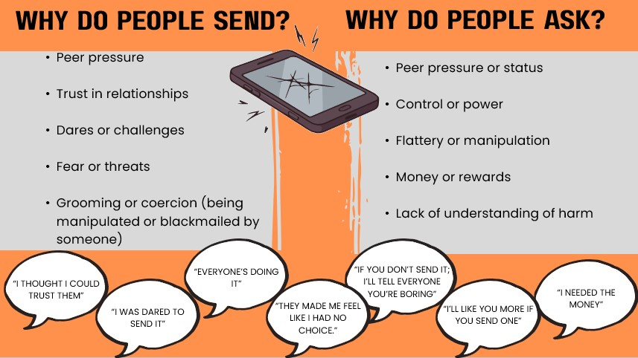
Notes:
This slide is split into two parts, because responsibility doesn’t sit in just one place. On the left‑hand side, we’re looking at why people send explicit images. These reasons often come from pressure, trust, fear, or being manipulated by someone else.
You might see things like ‘everyone’s doing it’, ‘I thought I could trust them’, ‘I was dared’, or ‘they made me feel like I had no choice’.
It’s really important to understand that feeling pressured, awkward, or unable to say no is very common and it is not the young person’s fault.
On the right‑hand side, we’re looking at why people ask for explicit images. This part of the conversation is just as important.
People might ask because they want attention, control, popularity, or to get something from someone else. Sometimes it’s framed as flirting, a joke, or part of a relationship.
This is the key point to pause on: asking for an image can still be pressure; even if it’s said as a joke, a compliment, or part of a relationship.
No one ever owes anyone an image. Responsibility lies with the person who asks, pressures, or shares; not with the person who felt pushed into sending.

Slide 5
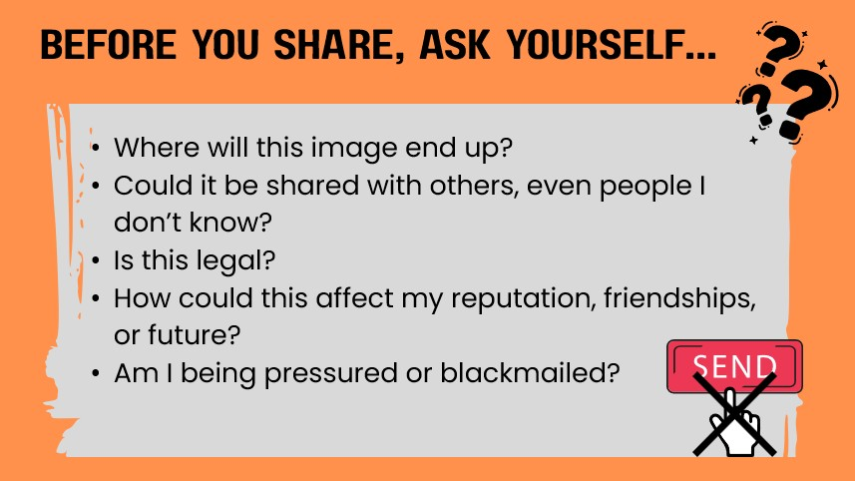
Notes:
This slide is about protecting yourself and having a moment to pause before sending anything.
These questions are here to help you stay safe; especially in situations where someone might be rushing you, pressuring you, or making it hard to say no.
It’s really important to say this clearly: being asked to think about risk does not mean blame sits with the person sending.
As we talked about on the last slide, pressure often comes from someone else’s behavior; from what they ask for or how they treat someone.
These questions are tools to help protect yourself in those situations, not rules that mean you’ve done something wrong.

Slide 6

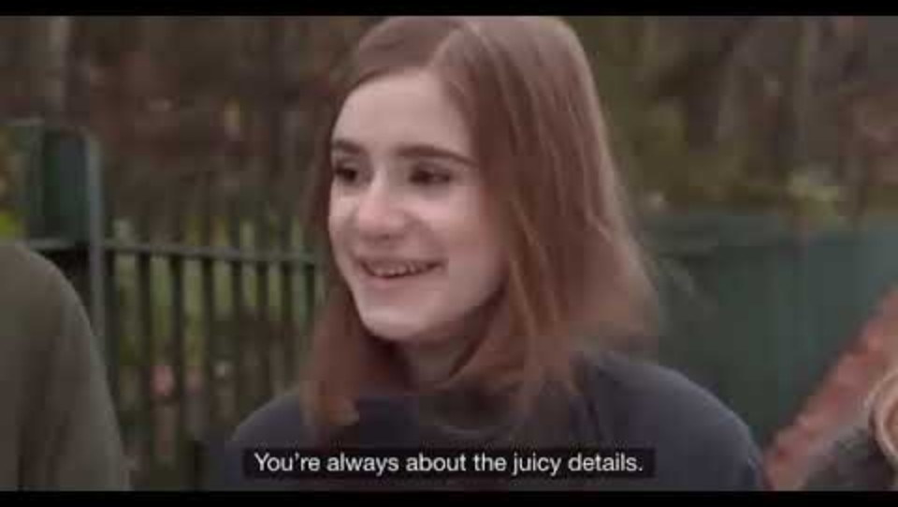
Notes:
Introduce the video:
We’re going to watch a short video created by Childnet, a charity that helps keep children and young people safe online.
The video looks at pressure – especially pressure that can happen in friendships or relationships online.
It shows how one small decision can turn into something much bigger than expected.
While you’re watching, you don’t need to say anything.
Just think about:
How the characters are feeling
Where pressure shows up
And what choices people make
If at any point this topic feels personal or uncomfortable, that’s okay. You’re not in trouble, and you’re not alone.
We’ll talk afterwards about where you can get help and support.

Slide 7
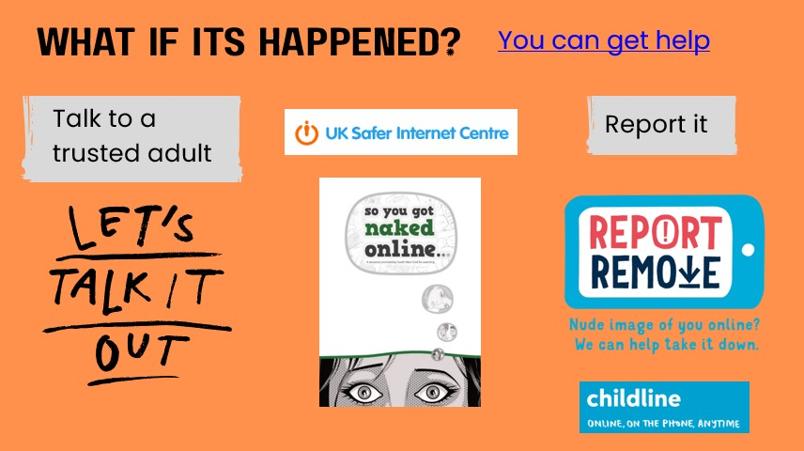
Notes:
If this has happened to you or someone you know, you can get help.
Talk to a trusted adult.
We know it’s awkward – But it’s important that you speak up - whether it’s to a parent, carer, or a teacher you trust.
Visit UK safer internet centre: ‘So You Got Naked Online’.
Use Childline’s ‘Report Remove’ to ask for the image to be taken down.

Slide 8
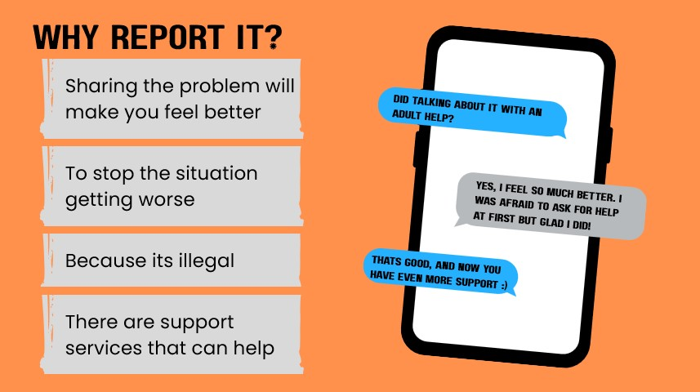
Notes:
Explain why reporting is important:
You are not in trouble; the person who asked, pressured, threatened, or shared images is the one responsible and has broken the law.
Reporting helps protect you and stops the offender from harming others.
It can prevent the situation from escalating and reduce emotional stress.
Support services like Childline, CEOP, and school safeguarding teams can help you feel safe and regain control.
Police treat these cases sensitively. Their focus is on protecting victims, not punishing them.
Even if you’ve sent an image, you are still the victim of exploitation or grooming and you deserve help.

Slide 9
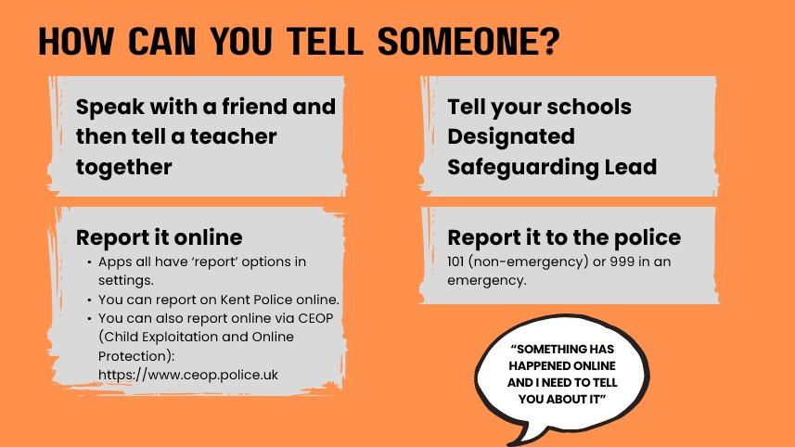
Notes:
Reporting doesn’t have to mean talking to a teacher alone. You could:
Speak with a friend first, then tell a teacher together if that feels easier.
Report it online:
Use the app’s built-in reporting tools (Snapchat, Instagram, TikTok, WhatsApp all have “Report” options in settings or on the message).
Block the person who is pressuring or threatening you. You can report to kent police online.
You can also report online via CEOP (Child Exploitation and Online Protection): https://www.ceop.police.uk.
Report to safeguarding:
Tell your school’s Designated Safeguarding Lead (DSL) or a trusted adult.
Report to the police:
If you feel unsafe, threatened, or blackmailed, call 101 (non-emergency) or 999 in an emergency.
Telling someone doesn’t mean you’re getting yourself into trouble; it’s about keeping you safe and stopping the person causing harm from doing it to others.
Most important: Don’t keep it a secret. You may need support, and there are people who can help.

Slide 10
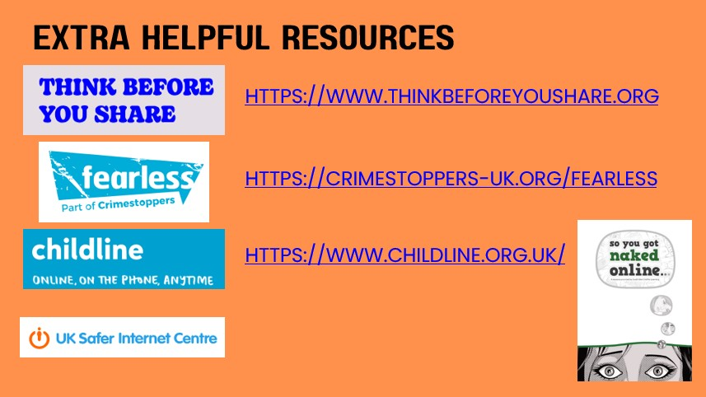
Notes:
Think Before You Share
- Helps young people understand the risks of sharing images online.
- Offers practical tips on staying safe and making smart choices before posting or sending anything.
- You can use it to learn how to protect your privacy and avoid pressure.
Fearless (Crimestoppers)
- A safe, anonymous way to report crime or exploitation without giving your name.
- Young people can use this if they feel threatened, blackmailed, or know someone is in danger.
-It’s confidential and designed for under-18s.
Childline
- Free, confidential support for anyone under 19.
- You can call 0800 1111, chat online, or use message boards for advice.
- Great for emotional support and practical help if they feel worried or pressured.
UK Safer Internet Centre
- Provides advice on staying safe online, including guides for social media and apps.
- Young people can use it to learn how to report harmful content and block users.
So You Got Naked Online
- A step-by-step guide for what to do if an image has already been shared.
- Helps young people regain control, remove images, and get support.
- Practical, reassuring advice for a stressful situation.

