Slide 1
Peer Mentor Training

Slide 2
Ice Breaker
How high can you count?
Between us, how high can we count without duplicating? If we start at 1, can we get to 30? If we say a number at the same time, we go back to the beginning. Let’s try…

Slide 3
Overview of Training
What is Peer Mentoring?
What skills are needed to be a Peer Mentor?
Views & Beliefs
Communication – Listening, Questioning
Bullying
Self-esteem & Emotional Wellbeing
Confidentiality
Support for Peer Mentors
Next Steps

Slide 4
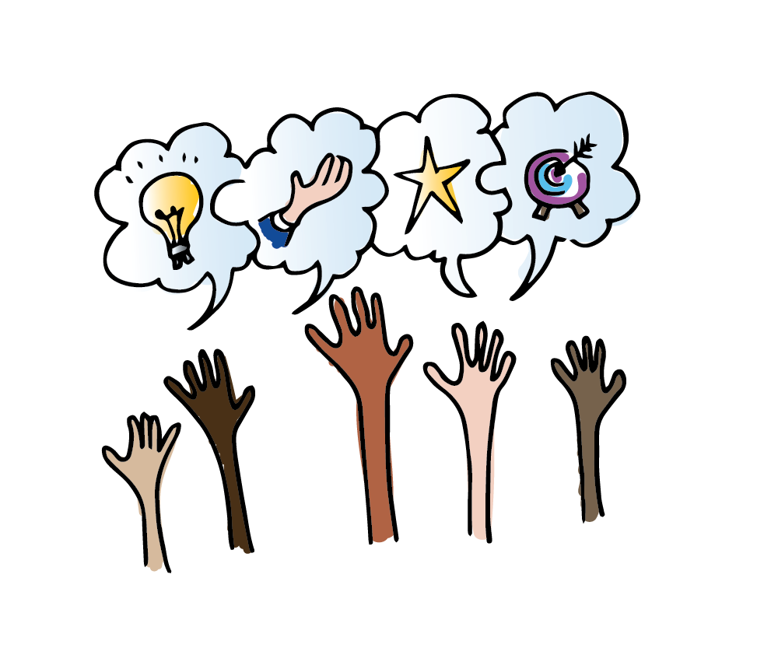
What is Peer Mentoring?
Peer Mentoring is a non-judgemental relationship where an individual (mentor) volunteers time to support and encourage another (mentee).
Peer mentors provide advice and guidance and act as a positive role model.
Notes:
Peer mentors are people who offer support and understanding to other young people of a similar age, with the aim of helping them with their emotional wellbeing and help build their resilience.
Peer mentors provide advice and guidance whilst acting as a positive role model for younger people who require their support.

Slide 5
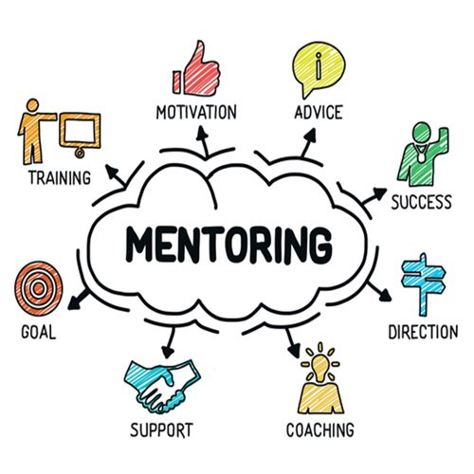
A Peer Mentor is…
A good listener
A good communicator
A positive role model
Advises others
Offers support

Slide 6
What skills and qualities are needed?
What skills do you think you need to be a good Peer Mentor?
What qualities do you think you need to be a good Peer Mentor?
What impact do you think a peer mentor would have on someone else?

Slide 7
Peer Mentor
Job Description
To help others
To advise others
To be kind and caring
To encourage others to participate in games
To listen to others and communicate properly
To be a good role model
To have fun!
What else do you think?
Notes:
Peer mentors are people who offer support and understanding to other young people of a similar age, with the aim of helping them with their emotional wellbeing and help build their resilience.
Peer mentors provide advice and guidance whilst acting as a positive role model for younger people who require their support.

Slide 8
Despite our different backgrounds, it is very important that we put in our absolute best to try and see from other peoples’ perspectives. The more you learn about others, the more you will feel able to support other people. Your experience in these discussions will help you to support others in similar situations in the future.
Views
& Opinions

Slide 9

What’s important to you?
Looking below, choose 4 things you consider to be important to you:
Rising to a challenge
Getting a good job
Equality
Praise/recognition
Making Friends
A nice environment
Knowledge
Success
Honesty
Being part of a group
Achievement
Rewards
Having a lot of work to do
Being important
Doing different things
Qualifications
Learning tolerance
Pleasure

Slide 10
Why do I need to be a good listener?
To gather information
To show respect
To keep safe
To gain feedback
To learn
To build relationships
Eye contact
Non-verbal gestures
Asking questions
Let’s list all the reasons you think it is important to be a good listener.
How do we demonstrate being a good listener?
Notes:
Peer mentors are people who offer support and understanding to other young people of a similar age, with the aim of helping them with their emotional wellbeing and help build their resilience.
Peer mentors provide advice and guidance whilst acting as a positive role model for younger people who require their support.

Slide 11

Passive and Active Listening
There are two different types of listening which people do.
These are known as active and passive listening:
Passive listening is when you do not verbally respond, but you may use body language e.g. eye contact, smiles, nods, etc instead.
Active listening involves responding verbally and checking your understanding of what is being said.

Slide 12
6 Tips for Active Listening #LittleThings (youtube.com)
Active listening is a skill! Here's how it's done. | What's Your Story? | Heartlines (youtube.com)
Active Listening. How to be a great listener.
Communication Skills: Empathetic Listening - Inside Out, 2015
Notes:
Listening Tips

