Slide 1
PEER MENTOR TRAINING

Slide 2
Check In
Let us know how you are doing today by scoring yourself between 0 and 10.
0 being the worst and a possible 10 being the best possible.
Notes:
Group to have a check –in together. Young people to say how they’re feeling today out of 10 and to be given the option to discuss why. Adults to join in with this and model the check in for the group.

Slide 3
GROUND RULES
1. Confidentiality - what is said in this room stays here.
2. Respect other peoples’ emotions. Some things we talk about may be upsetting.
3. Respect other people’s opinions/property.
4. Take part in all activities.
5. Listen to each other.
6. Be polite.
7. Support each other.
As a group it is important that we have rules which we all agree with and will follow when taking part in the session.

Slide 4
Overview of Training
What is Peer Mentoring?
What skills are needed to be a Peer Mentor?
Views & Beliefs
Communication – Listening, Questioning
Bullying
Self-esteem & Emotional Wellbeing
Confidentiality
Support for Peer Mentors
Next Steps

Slide 5
Hopes for the training
What are you hoping to gain from attending today?

Slide 6
Ground Rules

Slide 7
What is Peer Mentoring?
What is a Peer Mentor?
A good listener
A good communicator
A positive role model
Advises others
Offers support
Notes:
Peer mentors are people who offer support and understanding to other young people of a similar age, with the aim of helping them with their emotional wellbeing and help build their resilience.
Peer mentors provide advice and guidance whilst acting as a positive role model for younger people who require their support.

Slide 8
Peer Mentoring is…
a non-judgemental relationship where an individual (mentor) volunteers time to support and encourage another (mentee).
Peer mentors provide advice and guidance and act as a positive role model.

Slide 9
What skills and qualities are needed
What skills do you think you need to be a good Peer Mentor?
What qualities do you think you need to be a good Peer Mentor?
What impact do you think a peer mentor would have on someone else?

Slide 10
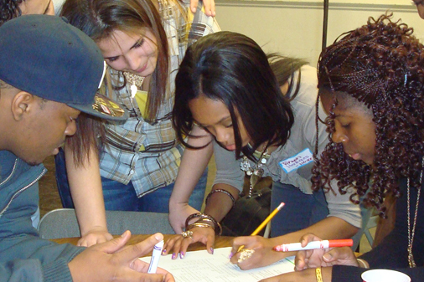
Peer Mentor Job Description
To help others
To advise others
To be kind and caring
To encourage others to participate in games
To listen to others and communicate properly
To be a good role model
To have fun!
Notes:
Peer mentors are people who offer support and understanding to other young people of a similar age, with the aim of helping them with their emotional wellbeing and help build their resilience.
Peer mentors provide advice and guidance whilst acting as a positive role model for younger people who require their support.

Slide 11
Views and opinions
Despite our different backgrounds, it is very important that we put in our absolute best to try and see from other peoples’ perspectives. The more you learn about others, the more you will feel able to support other people. Your experience in these discussions will help you to support others in similar situations in the future.
Views
& Opinions

Slide 12
Four Corners Game
Dreaded household chores, what do you like doing least?
1 - ironing, 2 – bathroom cleaning, 3 – doing the dishes, 4 - tidying your room
What flowers do you like?
1 - roses, 2 - daisies, 3 - tulips, 4 - wildflowers
What is your favourite season?
1 - Spring, 2 - Summer, 3 - Autumn, 4 - Winter
What is your favourite colour?
1 - red, 2 - pink, 3 - blue, 4 - green
If you could have a superpower, what would it be?
1 - invisibility, 2 - time travel, 3 - mindreading, 4 - strength
What is your favourite drink?
1 – fizzy, 2 – water, 3 – milk, 4 – juice
Which type of film do you prefer?
1 - comedy, 2 - romance, 3 - drama, 4 - action
If you were going to watch a sport, what would you prefer?
1 – football, 2- golf 3 - basketball, 4 - tennis
If we were having ice cream, what flavour would you choose?
1 - chocolate, 2 - vanilla, 3 - strawberry, 4 - banana
What is your favourite food?
1 - Chicken, 2 - Pizza, 3 - Burger, 4 - Pasta
Notes:
Peer mentors are people who offer support and understanding to other young people of a similar age, with the aim of helping them with their emotional wellbeing and help build their resilience.
Peer mentors provide advice and guidance whilst acting as a positive role model for younger people who require their support.

Slide 13
What’s important to you?
Looking below, choose 4 things you consider to be important to you:
Rising to a challenge
Pleasure
Success
Doing different things
A nice environment
Getting a good job
Equality
Praise/recognition
Making Friends
Knowledge
Honesty
Being part of a group
Achievement
Rewards
Having a lot of work to do
Being important
Qualifications
Learning tolerance

Slide 14
Ice Breaker
Share 3 things about you. 2 should be true and 1 should be a lie. The rest of the group must decide which is true and which is a lie.
2 Truths
and
A Lie

Slide 15
Listen and Draw Activity
Listen to your partner who is going to describe an image. Draw the image exactly how your partner describes it.
Notes:
Peer mentors are people who offer support and understanding to other young people of a similar age, with the aim of helping them with their emotional wellbeing and help build their resilience.
Peer mentors provide advice and guidance whilst acting as a positive role model for younger people who require their support.

Slide 16
Why do I need to be a good listener?
To gather information
To show respect
To keep safe
To gain feedback
To learn
To build relationships
Let’s list all the reasons you think it is important to be a good listener.
How do we demonstrate being a good listener?
Eye contact
Non-verbal gestures
Asking questions
Notes:
Peer mentors are people who offer support and understanding to other young people of a similar age, with the aim of helping them with their emotional wellbeing and help build their resilience.
Peer mentors provide advice and guidance whilst acting as a positive role model for younger people who require their support.

Slide 17
PASSIVE AND ACTIVE LISTENING There are two different types of listening which people do. These are known as Active and Passive listening.
Passive Listening
When doing this you do not verbally respond, but you may use body language e.g. eye contact, smiles, nods, etc.
Active Listening
This involves responding verbally and checking your understanding of what is being said.

Slide 18
Active listening
Notes:
Listening Tips

Slide 19
Active listening tips
Notes:
Active listening tips

Slide 20
Active listening: paraphrasing
Notes:
Paraphrasing

Slide 21
Active listening: Empathetic listening
Notes:
Emphatic listening

Slide 22
DIFFERENT TYPES OF QUESTIONING
Closed
Questions
Open
Questions
Probing
Questions
Notes:
Open Questions are when you want more information or the person to describe something and engage with the other person. Open questions usually start with what, why, who, where, when, which and how. For example “What did you do at the weekend?”, use “tell about your weekend”. It is a better way to open conversation.
Closed Questions are where the answer can only really be yes or no. This type of question is good for fact finding and gathering of information. Closed questions usually start with do, does, how, has, or, an, is, are. For example “did you enjoy the match?”
Probing Questions are when you want to get to the bottom of something. To get more information or to get more understanding for example “what exactly did you do at the match” and then you could ask “what happened?”

Slide 23
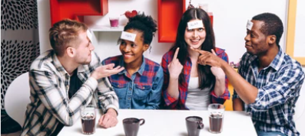
So who am I?
Ask away …

Slide 24
BODY LANGUAGE
Body language is the quiet, secret and most powerful language of all.
According to experts, our non-verbal language communicates about ______ of what we really mean the tone of our voice ______, while words themselves a only ____.
Fill in the blanks above with these percentages:
38%
55%
7%

Slide 25
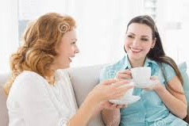
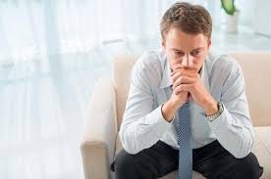
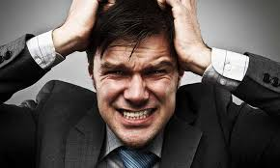
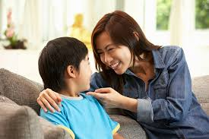
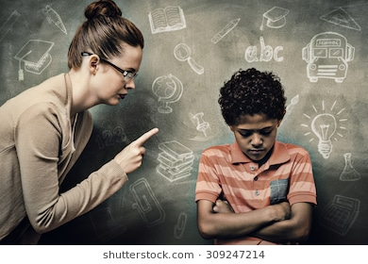
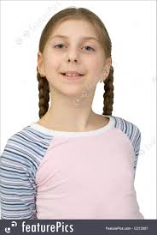
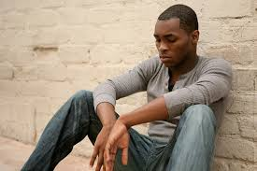
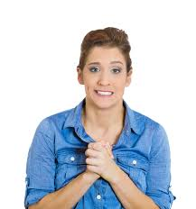
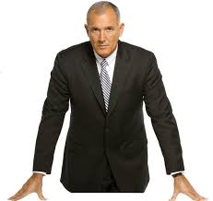
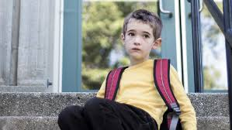
What do you think?
LOOK AT THESE IMAGES AND EXPLAIN WHAT IS HAPPENING.
8
4
1
7
10
3
11
5
9
6
2

Slide 26
Scenarios
Your mentee has fallen out with their best friend
Your mentee’s mum is in hospital
Your mentee’s mum is going to have a baby
Your mentee is scared of going on the playground
Your mentee is being bullied
Your mentee says that a teacher is picking on them
Your mentee likes a girl in his class
Your mentee has been having difficulty with their step- dad/step-mum
When discussing your scenario, consider these questions:
What does the person need to help them?
What impact could their behaviour have on them both immediately and in the future?
What do you think the hidden issues may be?

Slide 27
What is bullying behaviour
What is bullying behaviour?
Can you give us a definition of bullying?
The Anti-Bullying Alliance definition is:
The repetitive, intentional hurting of one person or group by another person or group, where the relationship involves an imbalance of power. Bullying can be physical, verbal or psychological. It can happen face-to-face or online.

Slide 28
What are the effects of bullying behaviour?
Most important to remember is that bullying behaviour is a barrier to learning, can seriously affect victims’ mental health and can change the way they feel about themselves well into their adulthood. Research shows that the long-term impact of bullying behaviour on a victim greatly increases if the bullying continues over a long period of time.

Slide 29
What types of bullying behaviour are there?
List as many as you can.

Slide 30
Spotting the signs of bullying behaviour?
What are the different ways you might be able to spot the signs that someone may be being bullied?
Let’s make a list:

Slide 31
What’s it like to be bullied

Slide 32
How can you help someone experiencing bullying behaviour? Young people in Kent say: “It’s not acceptable to be bullied in schools!”
Here’s what they suggest you do if experiencing this.
Tell a teacher, form tutor, Head of Year or another trusted adult in school or community setting Talk to your friends for support Speak to a Peer Mentor Try and stay with your friends in groups As best you can, stay out of their way Stand up for yourself but don’t escalate the problem Use Kooth.com to get support Try talking to them Report it straightaway Speak to the HeadStart Workers Talk to someone at home Use the Safe Space Try not to retaliate Speak up Take screenshots of any cyber bullying Do something you like Try not to react and especially show fear Don’t just think it’ll get better without telling someone. They can and they will help you

Slide 33
Game Break
What would you like to play?
The sun shines on…
21
Order according to….

Slide 34
Freddy’s Story 1
Freddy’s Story 2

Slide 35
CONFIDENTIALITY
When we think the other person is at risk
You are concerned about the person and need help
When we think the other person is at risk
It is important that the people we help trust us. Our conversations with them need to be kept private to help us keep that trust. Sometimes though it might be important to share the information. Can you think of when?

Slide 36
What can you keep confidential?
A boy comes to you and says they have been feeling sick every day before school due to anxiety.
Does this need to be shared?
The same boy a week later says his anxiety has been so severe that he is considering hurting himself.
Does this need to be shared?
A girl comes to you and says she is planning on meeting with somebody after school to have a fight with them because they threw a drink on her earlier that day.
Does this need to be shared?

Slide 37
What can you keep confidential?
The girl just before the end of the session says actually that she isn’t going to have a fight with them because she has changed her mind.
Does this need to be shared?
Your mentee has come to you and said they had a huge argument with their mum and they were both swearing at each other.
Does this need to be shared?
At the next session your mentee has said that they have continued arguing all week and said they were going to kick your mentee out if it continues.
Does this need to be shared?
At the next session your mentee says their mum has packed their bag and told them to leave home. Their mum said they don’t care where your mentee goes but they can’t live there any more.
Does this need to be shared?

Slide 38
What I am comfortable with?
What sort of issues I would feel comfortable to help someone with?
1.
2.
3.
What would / should I not be happy to help someone with?
1.
2.
3.
Who so I report issues to that I am not able to deal with?
1.
2.
3.

Slide 39
Where do I get support as a Peer Mentor?
Remember you are not super heroes. There will be times when you need to signpost a way forward for the people you support. Always talk to your staff member if you are concerned or unsure of any aspect of your role.
Identify 3 people you can go to for support?

Slide 40
How will it all work?
How will you promote Peer Mentoring? Would you like to do a presentation about the peer mentoring service in to your group? What would you say in the presentation? Will you design posters?
Where will you be based as Peer Mentors?
How will you be identifiable as Peer Mentors?
How often will you be on duty as Peer Mentors? Will there be a rota?
What do you do if you’re not sure about something?
When will the refresher sessions be?
When will we meet up as a group to review how it is going?
Who will be my mentee?
How do I flag any concerns?

Slide 41
Well done, you have completed the Peer Mentor training!

Slide 42
Any Questions?
?
?
?
?
?
?
?
?

Slide 43
CHECK OUT
Notes:
Group to have a check –in together. Young people to say how they’re feeling today out of 10 and to be given the option to discuss why. Adults to join in with this and model the check in for the group.

Slide 44
EVALUATION
Please complete the evaluation.
It helps us ensure we are meeting your needs and it’s fun for the next groups we will deliver to.

Slide 45
Closing information

