Slide 1
ANTI-BULLYING TRAINING
Co-produced with young people from Kent Youth Voice
Get Involved!

Slide 2
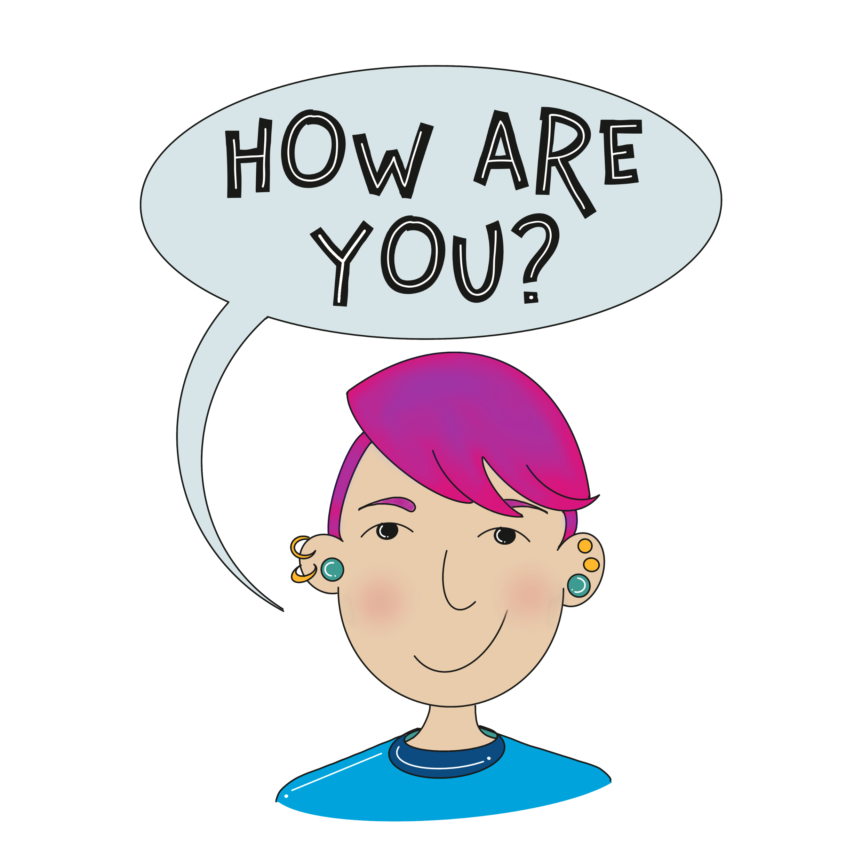
CHECK IN
Let us know how you are doing today by scoring yourself between 0 and 10.
0 being the worst and a possible 10 being the best possible.
Notes:
Group to have a check –in together. Young people to say how they’re feeling today out of 10 and to be given the option to discuss why. Adults to join in with this and model the check in for the group.

Slide 3
OUTCOMES OF TRAINING
Know what different types of bullying there are
Know some strategies to support and guide young people affected by bullying behaviour
A certificate
Notes:
We are learning about the meaning and impact of bullying behaviour, as well as exploring appropriate ways of responding to discriminating, hurtful or intimidating behaviour.

Slide 4
Icebreaker activity
Bullying Behaviour
Facts and Figures Quiz

Slide 5
What percentage of student’s report being bullied?
20%
30%
40%
10%

Slide 6
What is the most common form of bullying behaviour?
Emotional
Verbal
Physical
Cyber

Slide 7
What is the percentage of people who have been bullied at some point in their life?
A. 68%
B. 37%
C. 42%
D. 54%

Slide 8
What do you think causes bullying
What is the most common cause of bullying behaviour?
Interests
B. Clothing
C. Appearance
D. LGBTQ+

Slide 9
True or false
A. True
B. False
People who are part of the LGBTQ+ community are more likely to be bullied.

Slide 10
Answers
ANSWERS
1. A
2. B
3. D
4. C
5. A
How did you do?

Slide 11
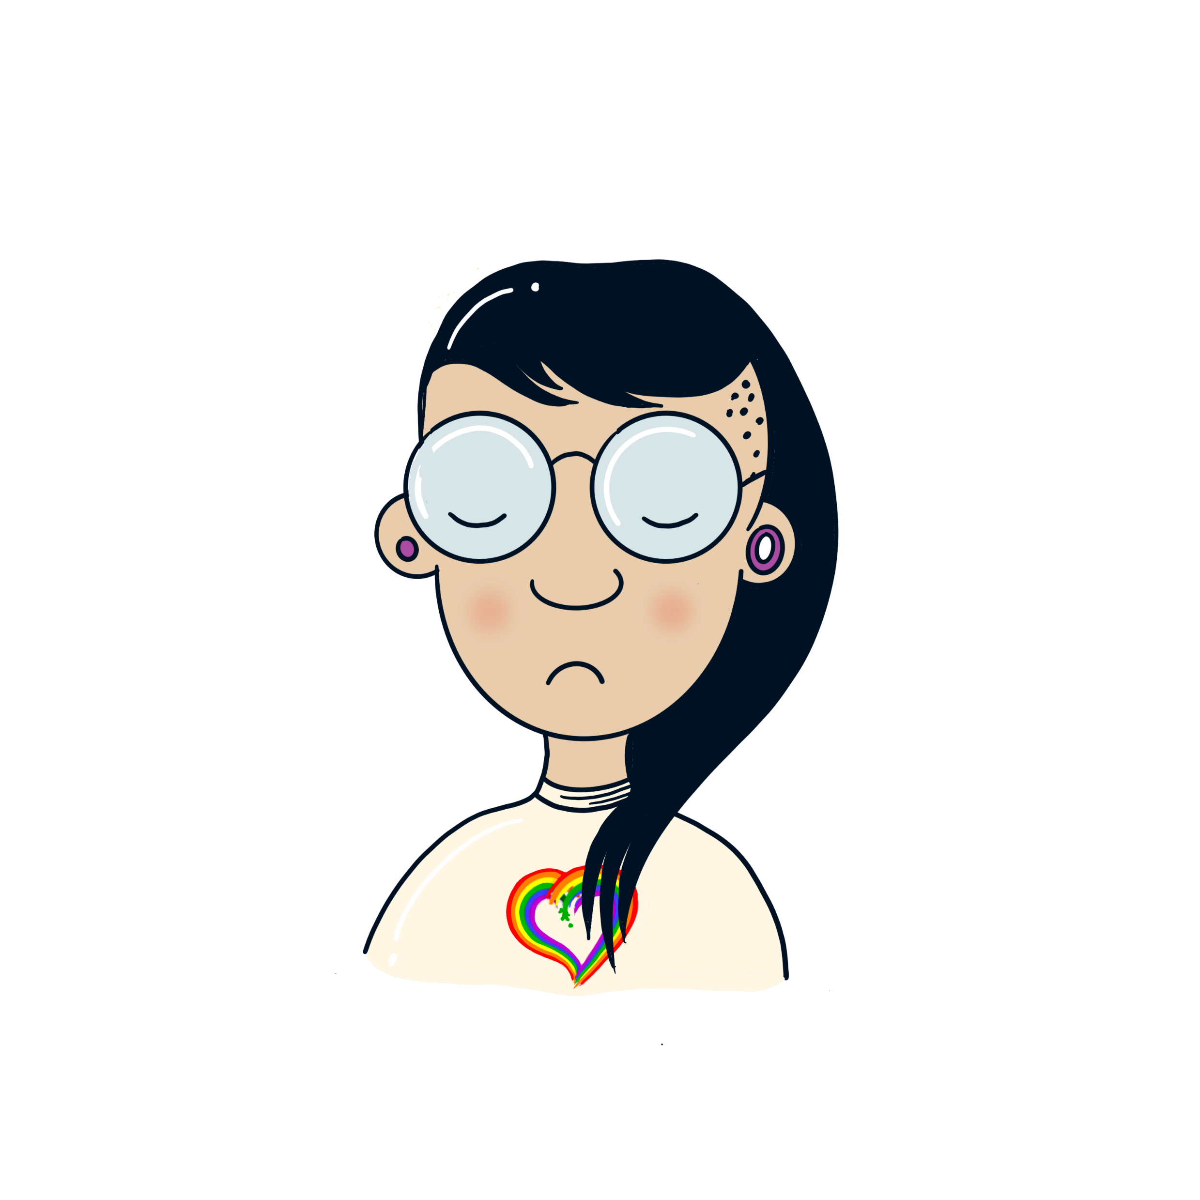
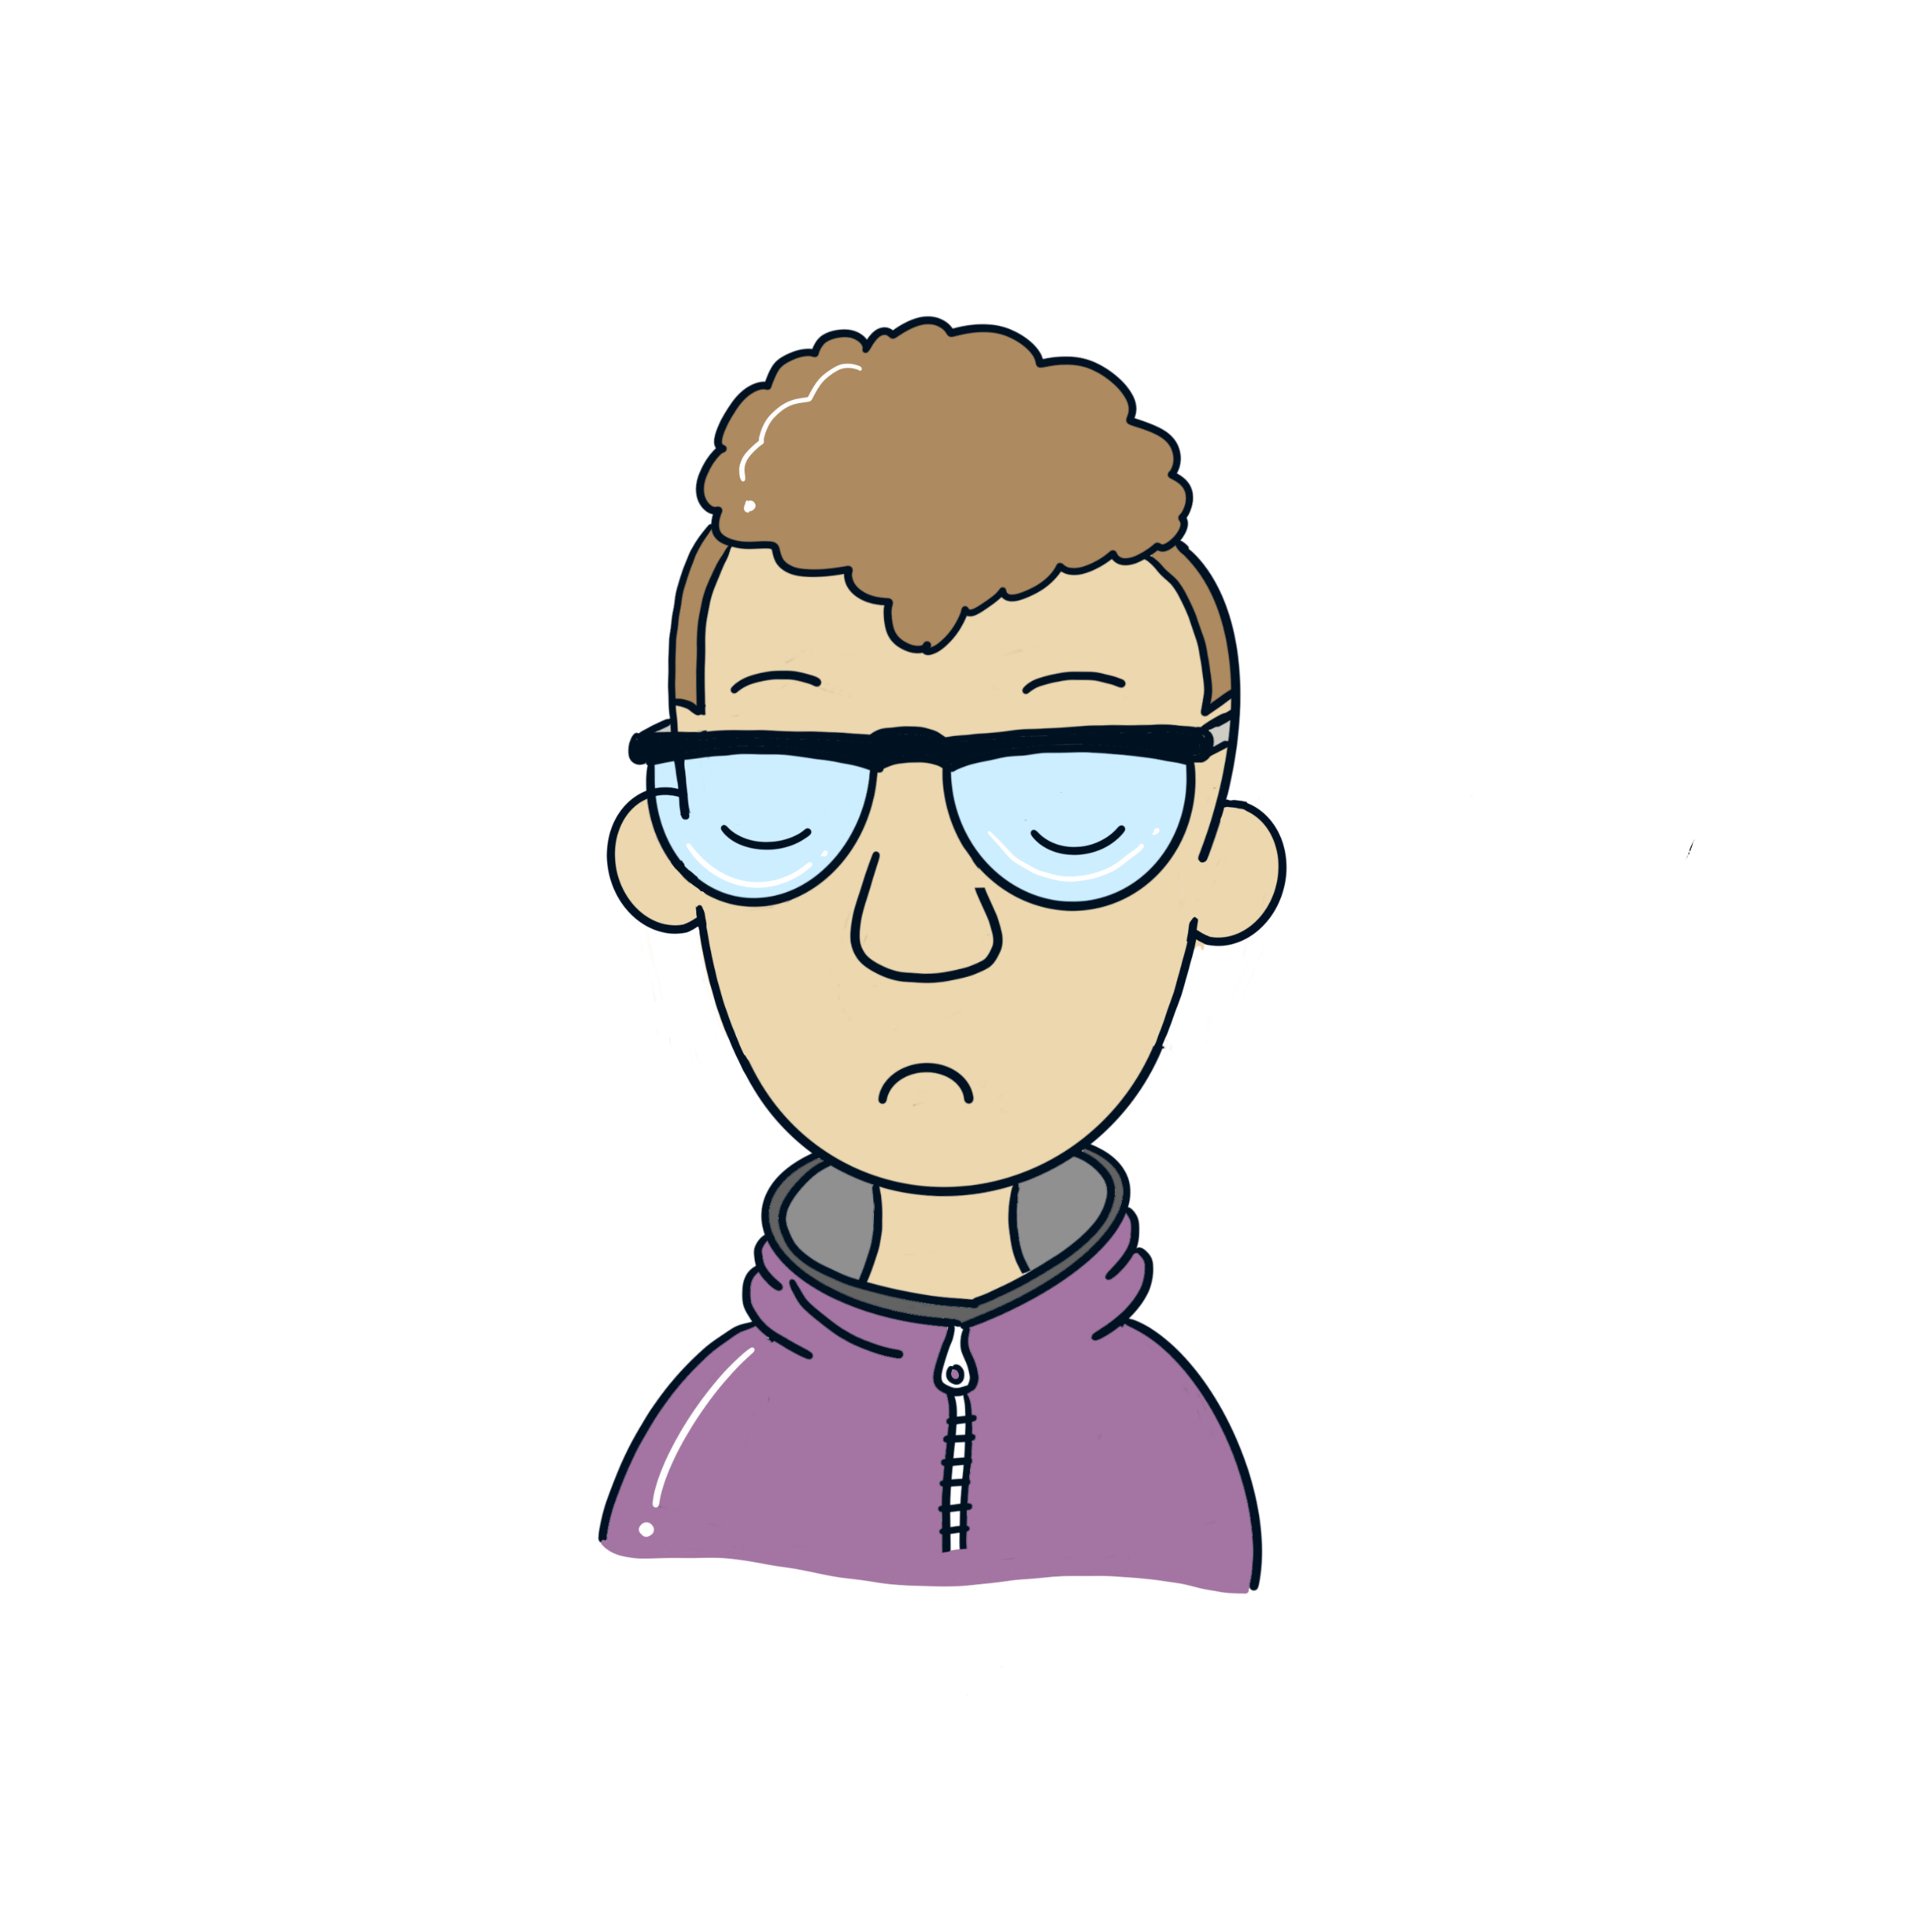
What is bullying?
Notes:
Bullying can be physical, verbal or psychological. It can happen face-to-face or online.

Slide 12
Can you define bullying?
The Anti-Bullying Alliance definition is “the repetitive, intentional hurting of one person or group by another person or group, where the relationship involves an imbalance of power.”
Notes:
The Anti-Bullying Alliance definition is “the repetitive, intentional hurting of one person or group by another person or group, where the relationship involves an imbalance of power.”

Slide 13
What are the effects of bullying behaviour?
Notes:
The most important to remember is that bullying behaviour is a barrier to learning, can seriously affect victims’ mental health and can change the way they feel about themselves well into their adulthood. Research shows that the long-term impact of bullying behaviour on a victim greatly increases if the bullying continues over a long period of time.

Slide 14
What types of bullying behaviour are there?
List as many as you can.

Slide 15
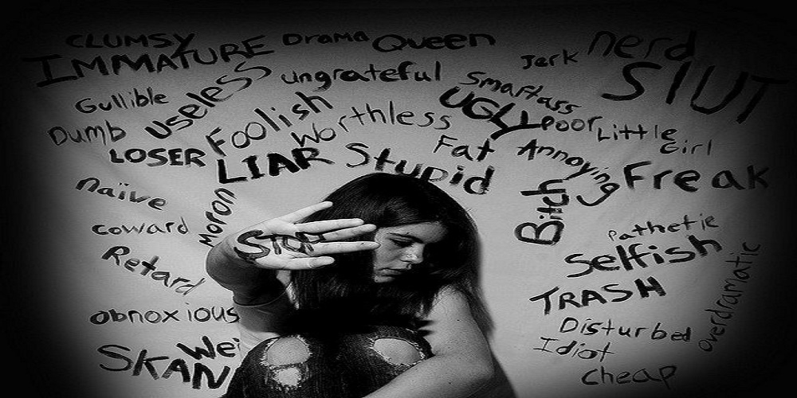
VERBAL BULLYING
How would you describe verbal bullying behaviour?
How might you know if someone is experiencing this?

Slide 16
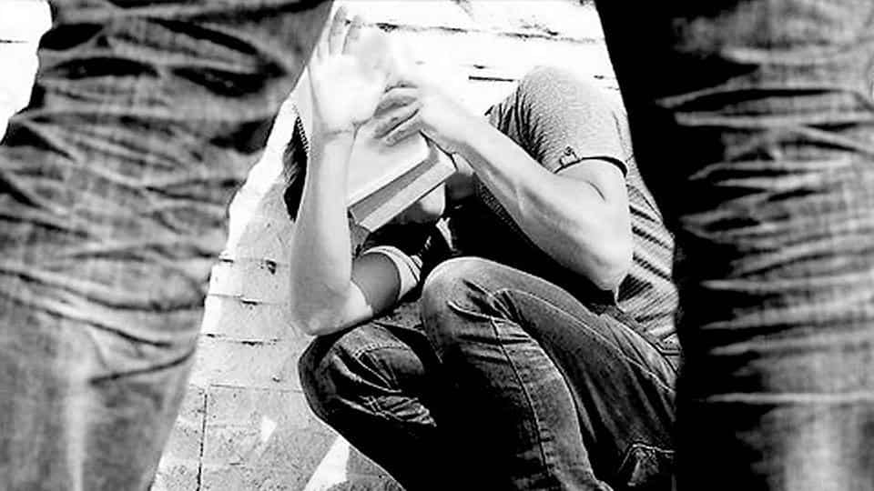
PHYSICAL BULLYING
How does physical bullying behaviour affect someone?
How would you support someone who is being physically bullied?

Slide 17
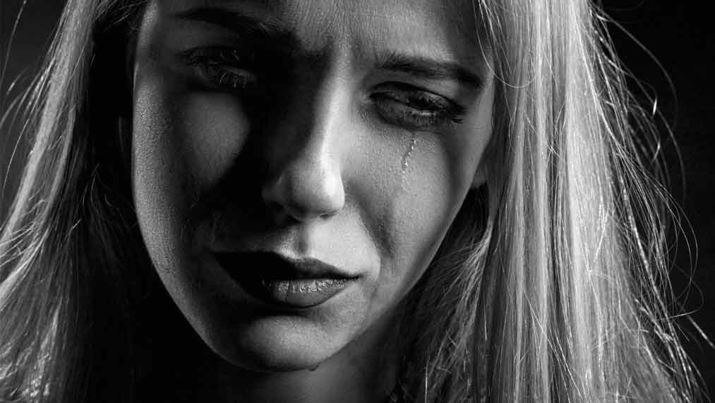
EMOTIONAL BULLYING
What do you think emotional bullying is?
How might you challenge emotional bullying?

Slide 18
Cyber bullying
CYBER BULLYING
How does cyber bullying differ from other types displayed?
How would you be able to tell if someone is being cyber-bullied?
How would you deal with it?

Slide 19
Spotting the signs of bullying behaviour
What are the different ways you might be able to spot the signs that someone may be being bullied?
Let’s make a list.

Slide 20
Video

Slide 21
Do you agree or disagree?
If someone is being bullied online, should they just shut down their account?
Banter is just banter. It isn’t bullying.
Should all types of bullying be against the law?
Is there such a thing as an innocent bystander when seeing someone being bullied?
Have the effects of bullying behaviour been exaggerated in society?
Notes:
The Anti-Bullying Alliance definition is “the repetitive, intentional hurting of one person or group by another person or group, where the relationship involves an imbalance of power.”

Slide 22
Scenario 1
Your friend tells you they are being bullied. They say they have told an adult, but nothing has happened.
What do you do?

Slide 23
Scenario 2
You are walking home from school with your friends to meet your sister. Some girls start to call you names. They get closer to you and approach. One of them punches you in the face and runs off.
What do you do?

Slide 24
Scenario 3
You posted a photograph of you with your new puppy on social media. People start posting nasty comments.
What do you do?

Slide 25
Draw your ideal anti-bullying ambassador
What qualities do they have?
Notes:
An Anti-Bullying Ambassador is someone that looks out for bullying behaviour, supports those that may be being bullied and is a listening ear to anyone that wants to talk to someone, other than an adult, about something going on.

Slide 26
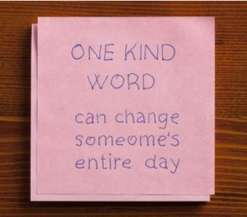
What can you do to help deal with bullying behaviour following on from this training?

Slide 27
Examples of what you could do
Share your voice against bullying behaviour on social media
Fundraise for your favourite charity
Speak up for a young person you know is being bullied
Set a better example to young people

Slide 28
Young people in Kent say…
“It’s not acceptable to be bullied in schools!”
Notes:
Lots of examples from young people coming up with suggestions of what to do if you find yourself in this situation…

Slide 29
Here’s what they suggest you do, if you experience this…1
Tell a teacher, form tutor, Head of Year or another trusted adult in school or community setting
Talk to your friends for support
Speak to a Peer Mentor
Try and stay with your friends in groups
As best you can, stay out of their way

Slide 30
Here’s what they suggest you do, if you experience this…2
Stand up for yourself but don’t escalate the problem
Use Kooth.com to get support
Try talking to them
Report it straightaway
Speak to the HeadStart Workers

Slide 31
Here’s what they suggest you do, if you experience this…3
Speak to the HeadStart Workers
Talk to someone at home
Use the Safe Space
Try not to retaliate
Speak up

Slide 32
Here’s what they suggest you do, if you experience this…4
Take screenshots of any cyber bullying
Do something you like
Try not to react and especially show fear
Don’t just think it’ll get better without telling someone. They can and they will help you

Slide 33
ANTI-BULLYING PLEDGE Part 1
I agree to respect others and take a stand against bullying by supporting young people around me and reporting bullying behaviour whenever I see it.

Slide 34
ANTI-BULLYING PLEDGE Part 2
This is including physical, verbal, cyber, racial, homophobic, religious, sexual, emotional and any other form of bullying.

Slide 35
ANTI-BULLYING PLEDGE Part 3
I believe that everybody has the right to feel safe, included, valued, accepted and always respected and will try my best to achieve this as an Anti-Bullying Ambassador.

Slide 36
EMERGENCY CONTACTS & SUPPORT

Slide 37
Being bullied is never your fault, under any circumstances. But we hope you are kind to yourself, and realise how important you are.
Notes:
We want to remind you that being bullied is never your fault. Under any circumstances.
We know it can make you feel isolated, angry and lower your confidence.
But we hope you are kind to yourself – and realise how important you are.

Slide 38
ANY QUESTIONS?
?
?
?
?
?
?
?
?

Slide 39
CHECK OUT
Let us know how you are doing after our session by scoring yourself between 0 and 10.
0 being the worst and a possible 10 being the best possible.
Notes:
Group to have a check –in together. Young people to say how they’re feeling today out of 10 and to be given the option to discuss why. Adults to join in with this and model the check in for the group.

Slide 40
EVALUATION
Please complete the evaluation.
It helps us ensure we are meeting your needs and it’s fun for the next groups we will deliver to.

Slide 41
Close

