Slide 1
INTERVIEW PANEL TRAINING

Slide 2
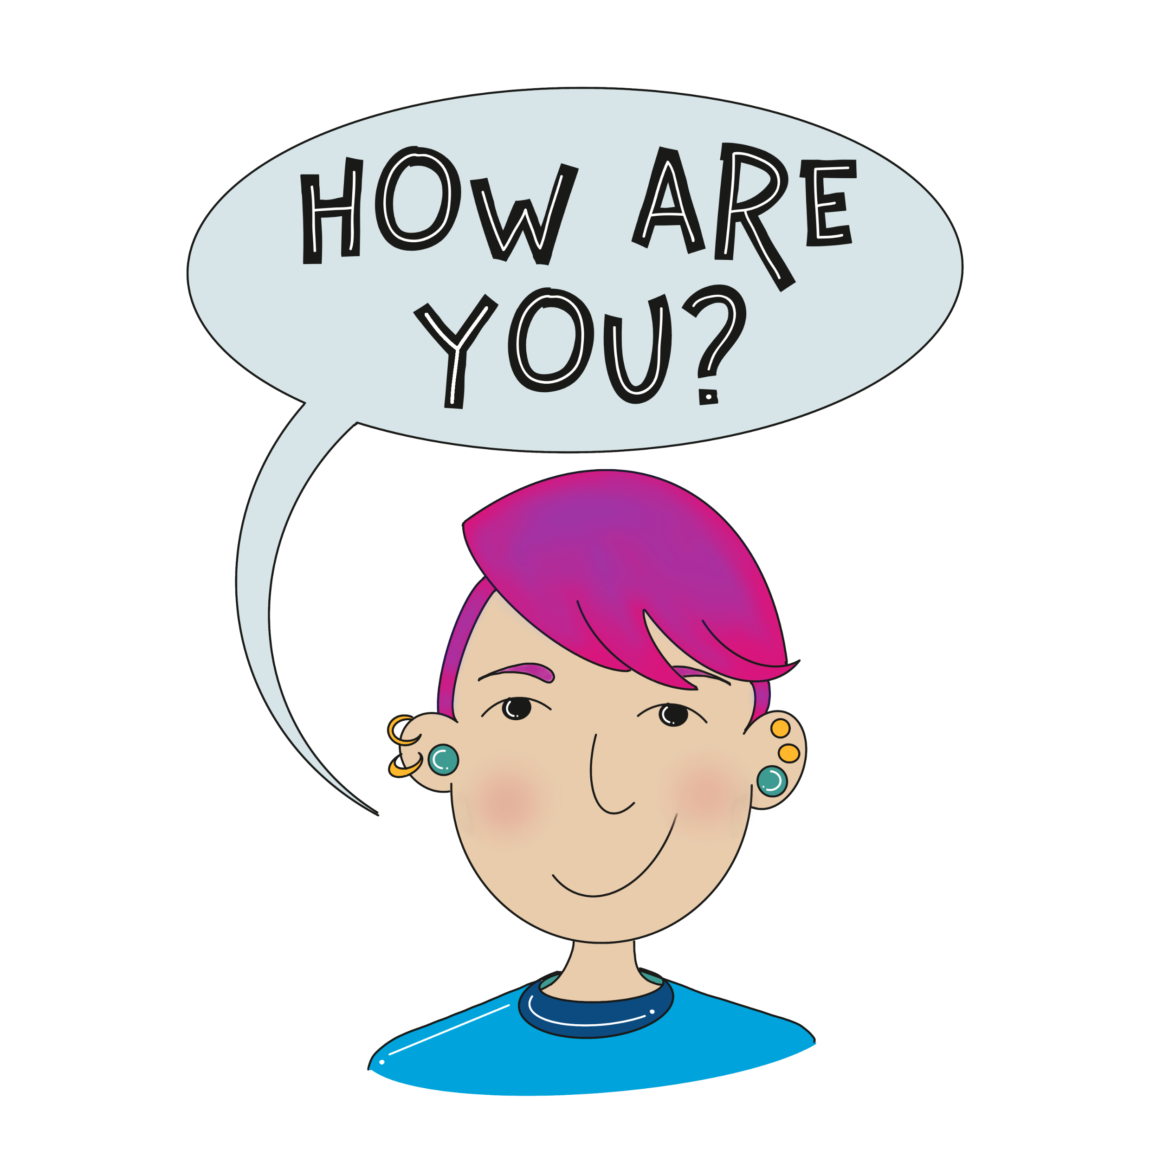
CHECK IN
Let us know how you are doing today by scoring yourself between 0 and 10.
0 being the worst and a possible 10 being the best possible.
Notes:
Group to have a check –in together. Young people to say how they’re feeling today out of 10 and to be given the option to discuss why. Adults to join in with this and model the check in for the group.

Slide 3
GROUP CONTRACT
Here are some of the ground rules we have come up with as examples.
1. Confidentiality - what is said in this room stays here.
2. Respect other peoples’ emotions. Some things we talk
about may be upsetting.
3. Respect other people’s opinions/property.
4. Take part in all activities.
5. Listen to each other.
6. Be polite.
7. Support each other.

Slide 4
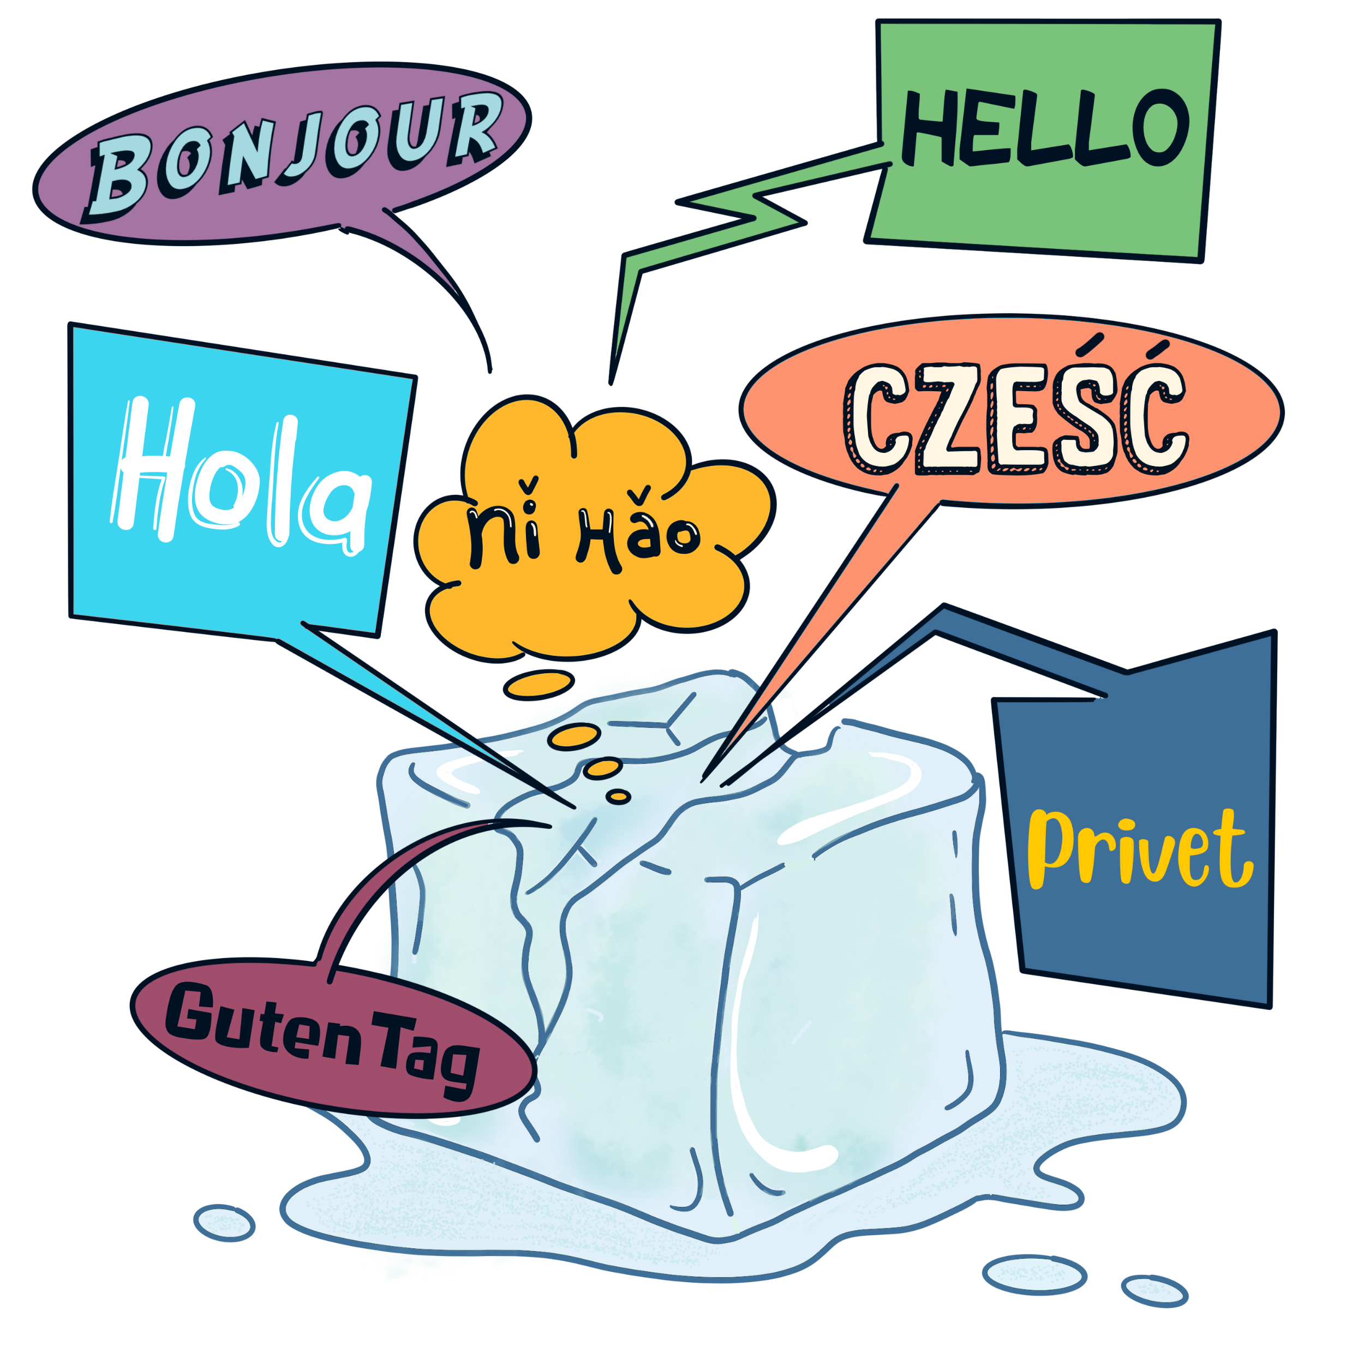
Two truths and a lie
Share 3 things about you. 2 should be true and 1 should be a lie. The rest of the group must decide which is true and which is a lie.

Slide 5
Aims for the Training
Understand the reasons and benefits for involving young people in the recruitment of new staff
Understand the interview process and your role within it
Understand about unconscious bias and the importance of fair recruitment
Gain valuable experience and insight into the interview process (your participation will look great on your CV)

Slide 6
Why involve young people in recruitment and selection of staff?
What are the benefits for the organisation?
What are the benefits for young people?

Slide 7
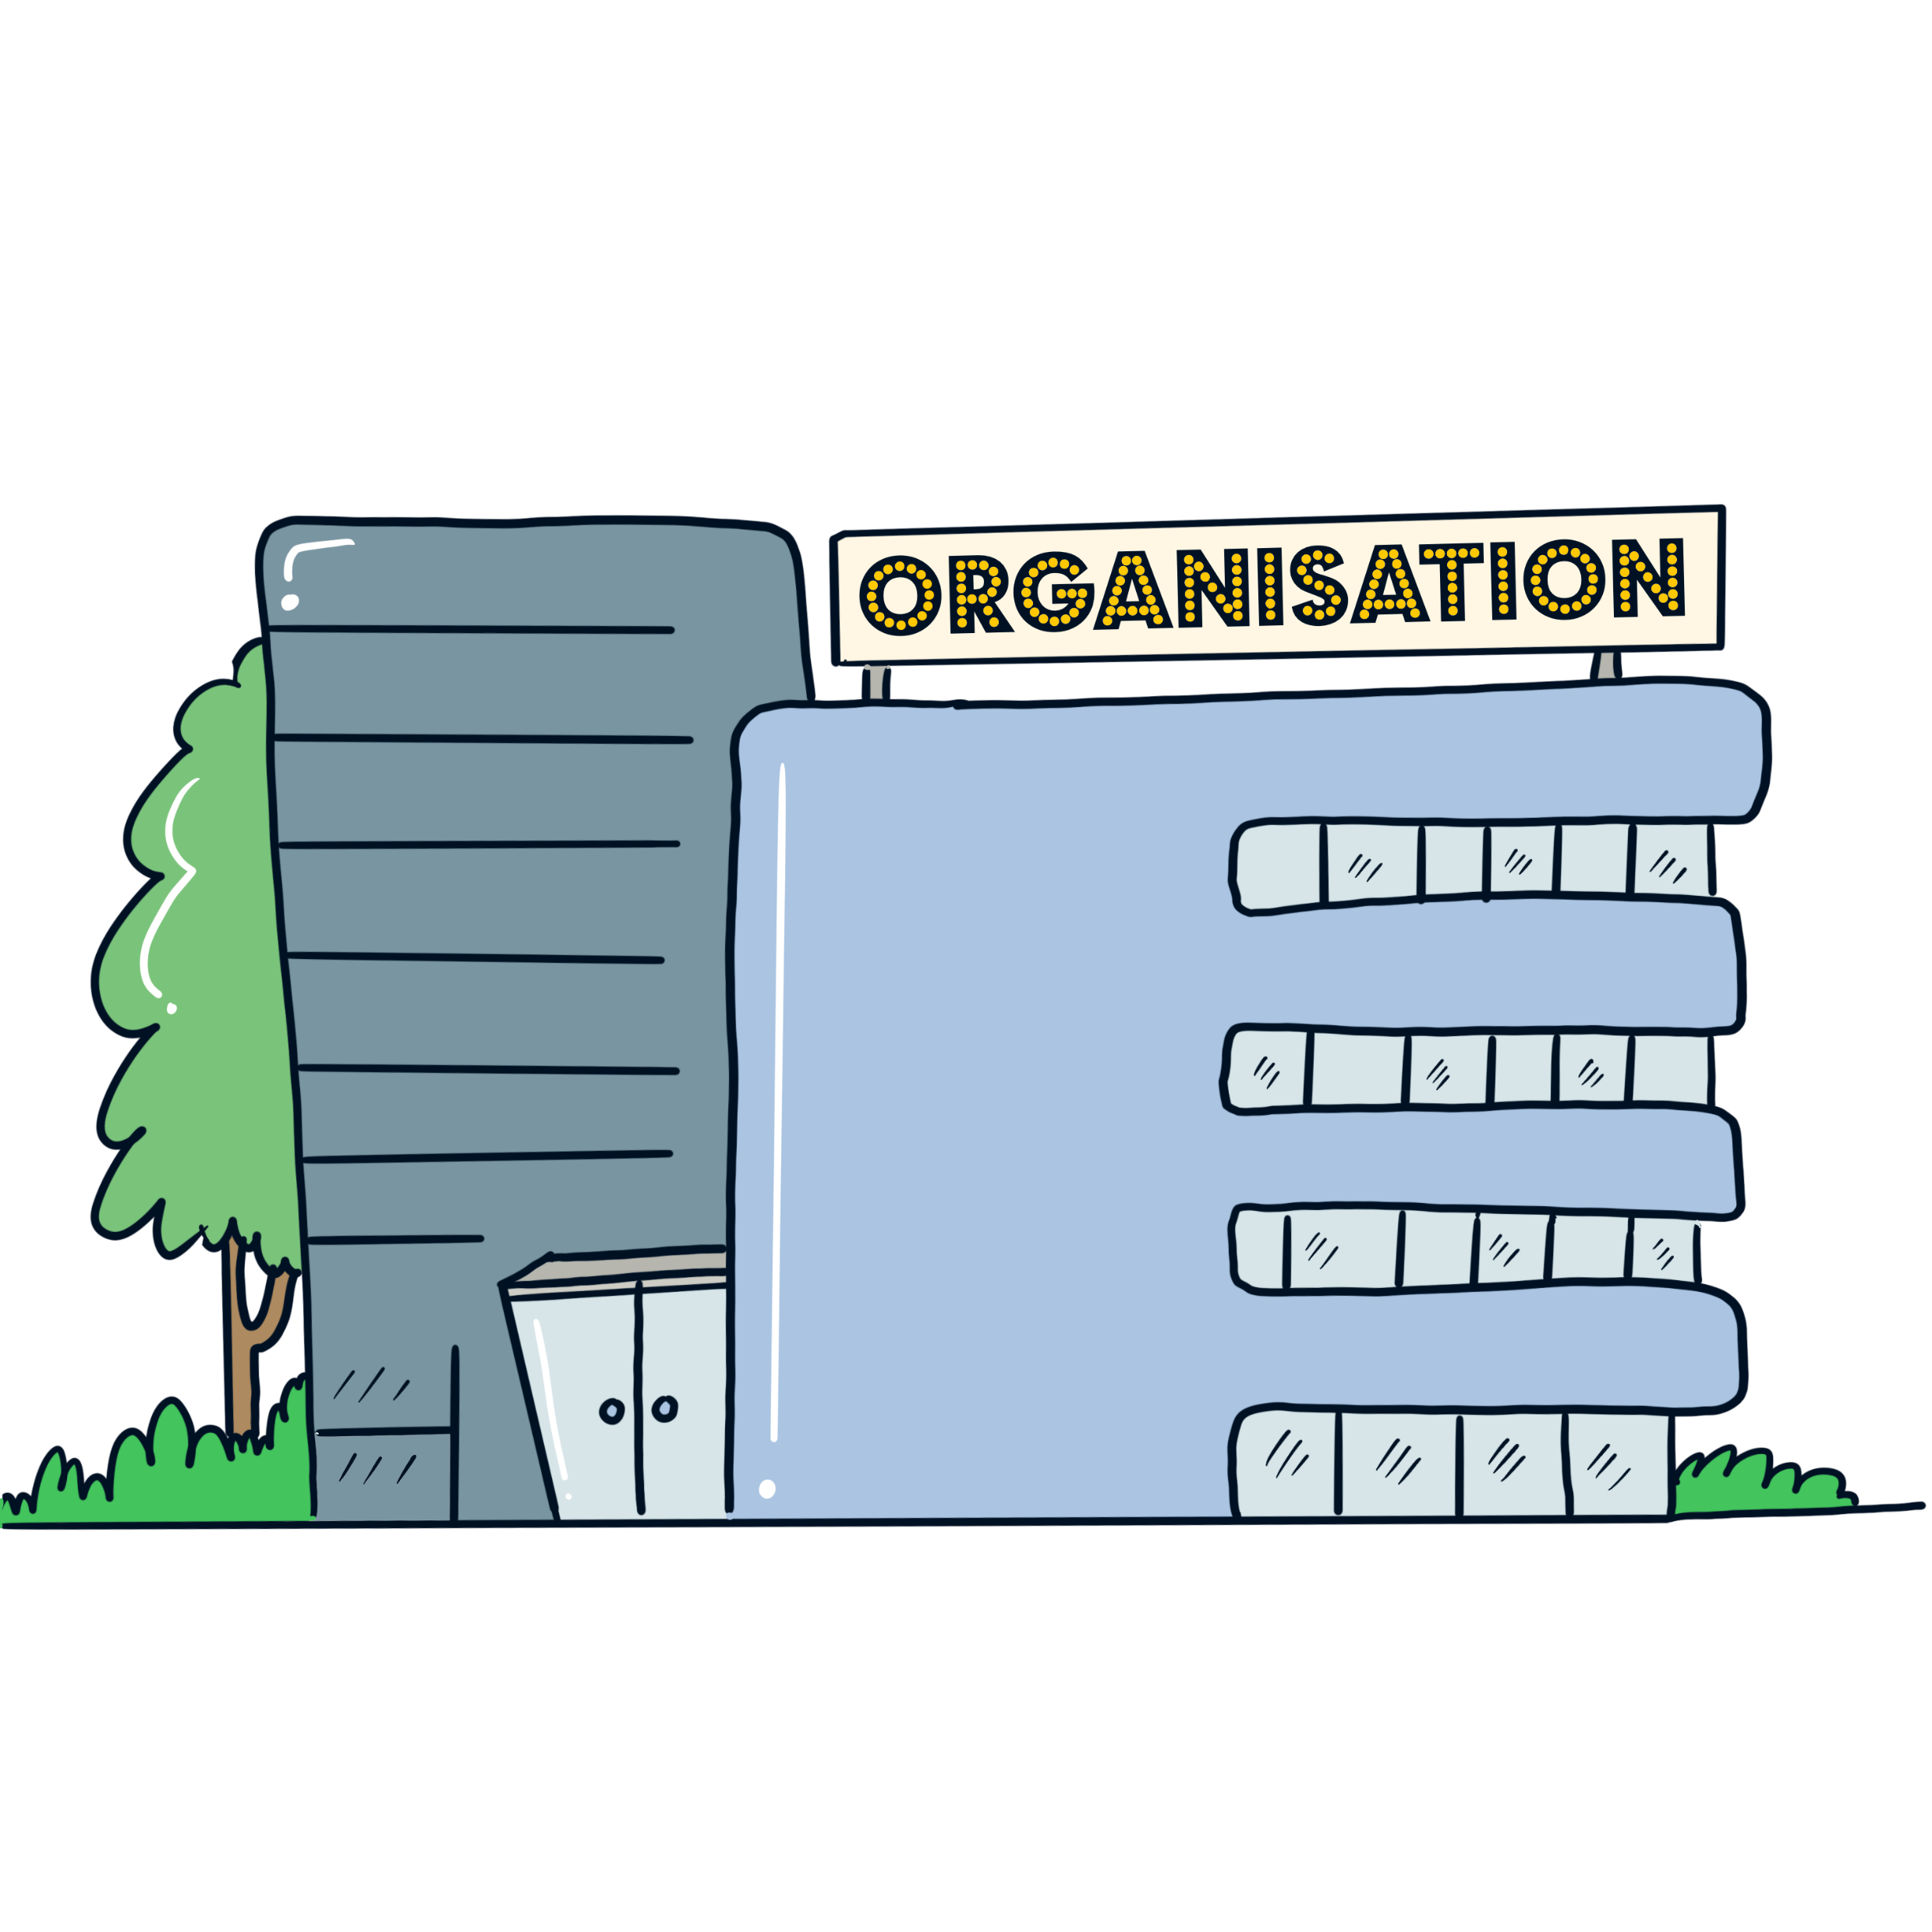
What are the benefits for the organisation?
It demonstrates commitment to Article 12 of the UN Rights of the Child.
Services become more accessible / more responsive / more efficient, by providing a more effective services for children and young people.
It increases the quality of our services, by selecting candidates whose personal skills and qualities suit the needs of young people and staff who can better relate to young people.
Can challenge presumptions about the needs of children and young people.

Slide 8
What are the benefits for the young people?
Develops vital social skills such as negotiation, debate, confidence and problem solving skills & experience for being interviewed in the future.
It creates a better balance of power between young people and professionals.
More likely to appoint staff who respect young people and then young people are more likely to respect them.
It supports the participation and empowerment of young people.

Slide 9
Why involve young people in recruitment and selection?
Article 12 (Respect for the views of the child) says:
Every child and young person has the right to express his or her views freely – about everything that affects him or her.
The child’s or young person’s views must be given due weight depending on his or her age and maturity.
The child or young person has the right to be heard in all decision making processes, including in court hearings. The child or young person can speak for him or herself, or someone else can speak for him or her.

Slide 10
What is the process candidates will go through?
Design job description & person specification
Vacancy
Make decision
Reference & checks
Job offer
Application Forms returned
Employee appointed
Interview
Shortlisting
The correct order is:
Vacancy
Design job description & person specification
Application Forms returned
Shortlisting
Interview
Make decision
Job offer
Reference and checks
Employee appointed

Slide 11
Video

Slide 12
Equality in recruitment and selection Why is it important to have a diverse workforce?

Slide 13
What is a job description?
What is a person specification?

Slide 14
Types of Questions What are ‘open’ and ‘closed’ questions?
Open questions are used to find out more detail and get the most information.
For example:
Please explain
Can you tell us…?
Closed questions are used to get a precise answer or detail. They are often answered with a ‘yes’ or ‘no’.
For example:
Have you…?

Slide 15
Are these Open or Closed questions?
Give an example of a crisis and how you handled it
What experience do you have of working with young people?
Have you any experience of
working with parents?
What made you apply for this job?
Do you think this job will interest you?
How would you improve the project?
Do you like working with young people?
What qualities do you think are important for a person working with young people?
Are you prepared to work unsociable hours?
Are you experienced in this work?
What would you say are your strengths?

Slide 16
Interview your partner. Ask them 5 questions about themselves and report back
What kind of questions did you ask?
Were you listening?
How did you make sure you could remember what they said?

Slide 17
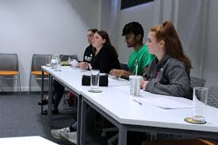
What questions would you like to ask the candidates?

Slide 18
Interviews Do’s and Don’ts
Do
Don’t
Be welcoming and Friendly
Use bad language, slang or jargon
Offer to repeat questions if needed
Talk when the candidate is talking
Switch your mobile phone off (unless you are using it for the meeting)
Yawn
Speak clearly and not too fast
Fidget
Look disinterested or bored even if you don’t like the candidate
Use your mobile phone during the interview
Try to look interested even if you are finding it boring
Listen while the candidate is talking

Slide 19
Confidentiality. Is it OK to…?
Tell your carers / teachers / social workers you are interviewing for staff & the post?
Tell your friends what you have been doing?
Talk about what one candidate said or did to another candidate?
Interview someone you know, for example: a family member? A Teacher? A Social Worker? A Youth Worker?
Put on social media that you are sitting on an interview panel or that someone got the job?
Tell people the names of candidates?
Tell people what you thought of the candidates?
Tell other people that you don’t agree with who got the job?

Slide 20
Confidentiality. Is it OK to…?
Put on social media that you are sitting on an interview panel or that someone got the job?
Tell people the names of candidates?
Tell people what you thought of the candidates?
Tell other people that you don’t agree with who got the job?
Notes:
Second part

Slide 21
ANY QUESTIONS?
?
?
?
?
?
?
?
?

Slide 22
Get Involved in Kent Youth Voice!
Kent Youth Voice brings together the Kent Youth County Council, SpeakOut at HeadStart and the Talk about Mental Health project.
Monthly meetings on a Saturday are currently running virtually on Teams.
KYV offers opportunities to work on campaigns and projects that are important to you.
Email us: headstart@kent.gov.uk to find out more.

Slide 23
Kent Youth County Council (KYCC) is a group of young people aged 11 to 18 years elected to represent and act upon the views, issues and opinions of the young people in Kent.
If you are interested in finding out more about KYCC, the current campaigns and how you can get involved then please email:
kycc@kent.gov.uk
or register your interest at www.kent.gov.uk/kycc

Slide 24
The Talk about mental health team
The TalkAboutMH team is lead by our Emotional Wellbeing Participation Workers, Sarah Haigh and Zoe Burns.
Sarah and Zoe work across Kent to capture the voices of young people and their families about their experiences of Mental Health Services.
Groups we run:
13 – 16 Group
17 – 22 Group
1:1 experience conversations
For more information please contact us via email:
talkaboutMH@kent.gov.uk

Slide 25
CHECK OUT
Let us know how you are doing after our session by scoring yourself between 0 and 10.
0 being the worst and a possible 10 being the best possible.
Notes:
Group to have a check –in together. Young people to say how they’re feeling today out of 10 and to be given the option to discuss why. Adults to join in with this and model the check in for the group.

Slide 26
EVALUATION
Please complete the evaluation.
It helps us ensure we are meeting your needs and it’s fun for the next groups we will deliver to.

Slide 27
Close

