Slide 1
Talents & Interests

Slide 2
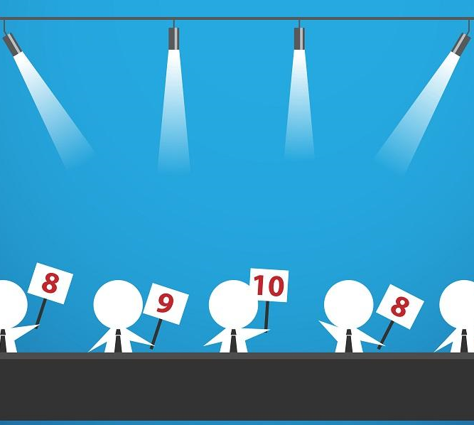
Check In
Let us know how you are doing today by scoring yourself between 0 and 10.
0 being the worst and a possible 10 being the best possible.
Notes:
Group to have a check –in together. Young people to say how they’re feeling today out of 10 and to be given the option to discuss why. Adults to join in with this and model the check in for the group.

Slide 3
GROUND RULES
1. Confidentiality - what is said in this room stays here.
2. Respect other people’s emotions. Some things we talk
about may be upsetting.
3. Respect other people’s opinions/property.
4. Take part in all activities.
5. Listen to each other.
6. Be polite.
7. Support each other.
As a group it is important that we have rules, which we all agree with, and will follow when taking part in the session.

Slide 4
ICE-BREAKER
The
Minute Masterpiece
Without looking at the paper, draw a portrait of your partner.

Slide 5
Discuss
What is Wellbeing?

Slide 6
Wellbeing is
“…. a good… condition of existence… Characterised by health, happiness, prosperity and welfare…”
or
“the state of being comfortable, healthy and happy”.
What do you think?

Slide 8
Discuss
What are talents and interests?
What are some of the barriers that may stop people accessing these?

Slide 9
Your thoughts
What are the benefits of engaging in a talent or an interest?

Slide 11
Talents & Interest grants
10-16 year olds
Trusted adult applies
£50 - £300 per grant
Group grants available
Evaluation after 2 months
Notes:
The scheme is designed to support young people identified by their schools and communities. A trusted adult from the school and/or communities can apply for a grant on the young person’s behalf in order to access hobbies such as sports, the arts or music. You can bid for £50 to £300 per grant. It will be a requirement of the grant to provide an evaluation 2 months after the activity has started.

Slide 12
Any Questions?
?
?
?
?
?
?
?
?

Slide 13
CHECK OUT
As we did at the beginning, let us know how you are doing now by scoring yourself from between 0 being the worst and a possible 10 being the best.
Notes:
Group to have a check –in together. Young people to say how they’re feeling today out of 10 and to be given the option to discuss why. Adults to join in with this and model the check in for the group.

Slide 14
EVALUATION
Please complete the evaluation.
It helps us ensure we are meeting your needs and it’s fun for the next groups we will deliver to.

