Slide 1
Pay It Forward

Slide 2
Check In
Let us know how you are doing today by scoring yourself between 0 and 10.
0 being the worst and a possible 10 being the best possible.
Notes:
Group to have a check –in together. Young people to say how they’re feeling today out of 10 and to be given the option to discuss why. Adults to join in with this and model the check in for the group.

Slide 3
Ground Rules
1. Confidentiality - what is said in this room stays here.
2. Respect other peoples’ emotions. Some things we talk about may be upsetting.
3. Respect other people’s opinions/property.
4. Take part in all activities.
5. Listen to each other.
6. Be polite.
7. Support each other.
As a group it is important that we have rules which we all agree with and will follow when taking part in the session.

Slide 4
The
Minute Masterpiece
Without looking at the paper, draw a portrait of your partner.

Slide 5
What is Wellbeing?

Slide 6
Wellbeing is
Wellbeing is
“…. a good… condition of existence… Characterised by health, happiness, prosperity and welfare…”
or
“the state of being comfortable, healthy and happy”.
What do you think?

Slide 7
HeadStart kent
Notes:
Play video introducing HeadStart Kent. HeadStart Kent is part of Kent County Council’s Integrated Children’s Services and aims to help young people cope better when faced with difficult circumstances in their lives, preventing them from experiencing common mental health problems. The programme is funded by The National Lottery Community Fund to provide the resources to develop approaches that support young people to develop their own resilience to cope with the everyday pressures they may face throughout their lives.

Slide 8
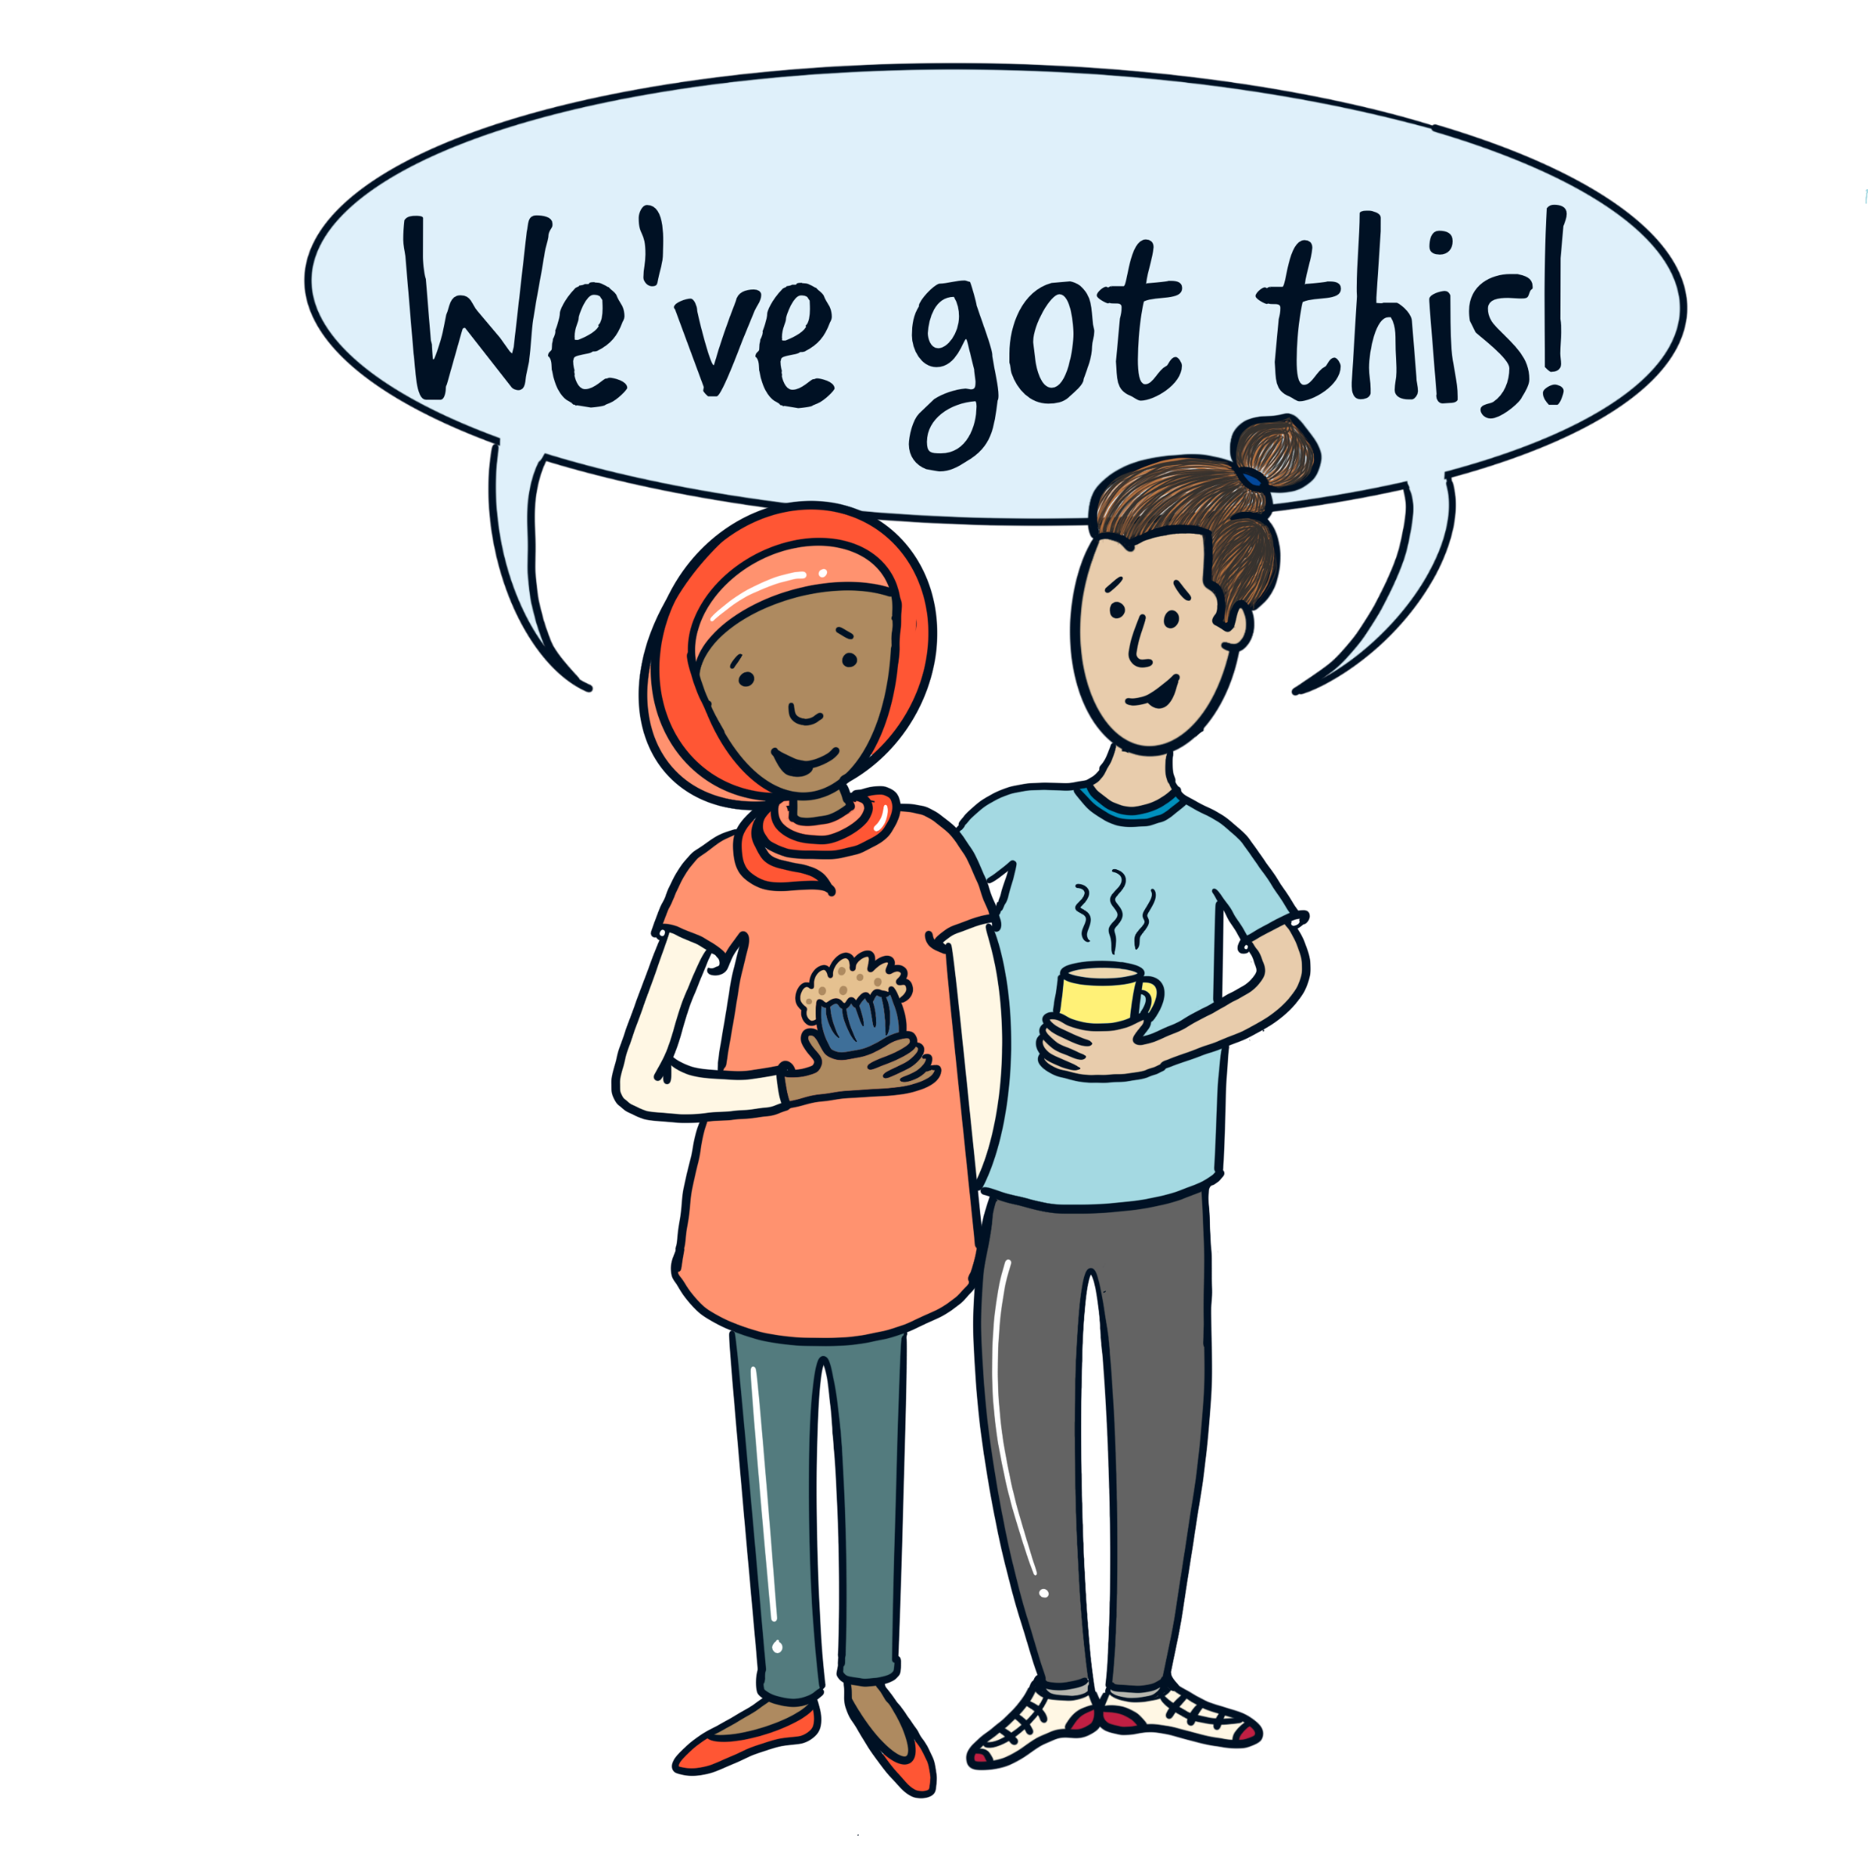
When was the last time you did something for somebody else?
Notes:
As a group or in pairs ask the Young People to discuss the last time they did something that helped somebody else. Ask Young People to feedback to the group how helping that person or persons made them feel. Feelings may include happiness, pride, a sense of achievement , determination.
Now discuss how it felt the last time someone did something for you . Feedback to the group.

Slide 9
What is pay it forward
Pay It Forward means doing something to help somebody else’s wellbeing.
HeadStart is giving groups of young people the chance to make this happen. providing grants of between £250 and £1,000 for projects led by young people aged 10 – 16
Notes:
The Pay It Forward scheme provides grants of between £250 and £1,000 for projects led by young people aged 10 – 16.
Pay It Forward means doing something to help somebody else’s wellbeing. HeadStart is giving groups of young people the chance to make this happen. The original idea for the fund came from Kent’s young people.
The Pay It Forward project should aim to improve the emotional wellbeing of other people, whether that be where young people live, at school, at a club or at another community organisation.

Slide 10
Pay it forward video
Notes:
The Pay It Forward scheme provides grants of between £250 and £1,000 for projects led by young people aged 10 – 16.
Pay It Forward means doing something to help somebody else’s wellbeing. HeadStart is giving groups of young people the chance to make this happen. The original idea for the fund came from Kent’s young people. The Pay It Forward project should aim to improve the emotional wellbeing of other people, whether that be where young people live, at school, at a club or at another community organisation.
Play you tube video that introduces Pay It Forward

Slide 11
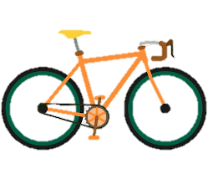
Let’s think of some ideas for a Pay It Forward project
Discuss who would benefit from these ideas?
Notes:
In pairs or as a group ask the Young People to think of ideas and suggestions for a Pay It Forward application and how they think there ideas could benefit others.

Slide 12
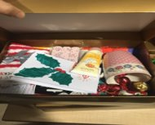
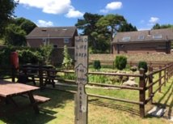
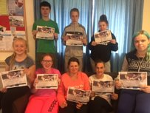
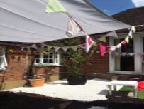
Pay it forward projects
Notes:
Previous successful Pay It Forward projects include: Sensory gardens and safe spaces in schools and youth centres. Anti-bullying projects in schools. School clubs including Lego, cookery, reading and sports. Making hampers for local care homes. Transition events for Year 6 leavers. Art and craft projects and a dance performance. One-off event for young people with special educational needs. Community gardening projects. Renovating a local pond.
Discuss the examples of Successful Projects.
Previous successful Pay It Forward projects include:
Sensory gardens and safe spaces in schools and youth centres.
Anti-bullying projects in schools.
School clubs including Lego, cookery, reading and sports.
Making hampers for local care homes.
Transition events for year 6 leavers.
Art and craft projects and a dance performance.
One-off event for young people with special educational needs.
Community gardening projects.
Renovating a local pond.
What were the groups thoughts on these projects? Could they see the benefits to them and how they can help others?

Slide 13
Pay it forward application information
“We score the PIF applications and we want to see young peoples involvement in all parts of the application, we also like to see a breakdown of where all of the money will be going!”
Applying for a PiF grant
The deadlines for each batch of applications in 2021 are:
9 April
11 June
20 August
9 October
4 December
Expect to hear a response within four weeks.
Notes:
Ensure projects are led by young people, although an adult must make the application and can help with planning.
Explain clearly in your application how your project will benefit the emotional health and wellbeing of others in your community.
Please include a detailed breakdown of costs, so the young assessors can see exactly how the money would be spent – include screenshots of websites for items on your shopping list.
Make your application is as visual as possible. The panel of young assessors welcome evidence of research and planning such as photographs, videos, mind-maps and quotes from the young people involved in the application process. They say:

Slide 14
Pay it forward successful project
“We asked for funding via the Pay it Forward grant scheme to make a film about mental health and receiving support in rural areas. The process was really easy. We applied for a grant of £1000 which was accepted and we received the full funding for filming. We were excited when we found out we had got the funding. Before filming we had made a plan of what we wanted to discuss and focus on. When we were filming we all spoke about receiving help and how to access support, where we said about how we had felt before and after being on the programme and how it had such a positive impact on all of us.
We all had an amazing time filming with the support of Pay it Forward. It felt really good to speak about our experiences. Once we had filmed the clips they were edited and we titled our film ‘Remote but not Alone’. It was put on social media (YouTube, Twitter, Facebook). We received positive feedback and it was really encouraging to hear good things about something we are all so passionate about and feel so personally towards.
The whole experience on the programme and with Pay it Forward was extraordinary and life changing., It is something we will all value for the rest of our lives and will always be grateful for.”
You can make a massive difference!
Notes:
Discuss the testimony about the mental health film (Remote But Not Alone) and how this application made a difference to other people’s lives.

Slide 15
Any Questions?
?
?
?
?
?
?
?
?

Slide 16
CHECK OUT
Notes:
Group to have a check –in together. Young people to say how they’re feeling today out of 10 and to be given the option to discuss why. Adults to join in with this and model the check in for the group.

Slide 17
EVALUATION
Please complete the evaluation.
It helps us ensure we are meeting your needs and it’s fun for the next groups we will deliver to.

Slide 18
Closing slide

