Slide 1
www.kentresiliencehub.org.uk www.moodspark.org.uk
Names
Notes:
Introductions - who delivering training

Slide 2
A Whole School Approach
and
Staff Wellbeing
Notes:
Welcome and Introductions

Slide 3
Objectives for today
To understand the eight principles of a Whole School Approach to wellbeing and how to apply them.
To be able to prioritise areas for your school to focus on.
To provide some tools and techniques to support your own wellbeing, as well as others.
Notes:
To understand the eight principles of a Whole-School Approach to wellbeing and how to apply them.
To provide some tools and techniques to support your own wellbeing, as well as others.

Slide 4
House Keeping
Mobile phones on silent, if you need to take a call please step outside the room.
Please acknowledge other people’s right to be heard, please listen to colleagues when they are talking.
Keep an open mind.
Respectful challenge is encouraged.
Notes:
Tell the group whether there is a fire alarm test or not for the duration of the workshop. In the event of a real fire, leave at the exits, direct to exits, and meet at the muster point. Tell the group where this is.
Conditions for Learning (Ground Rules)
Mobile phones on silent, if you need to take a call please step outside the room.
Please acknowledge others right to be heard, please listen to colleagues when they are talking.
Keep an open mind.
Respectful challenge is encouraged.

Slide 5
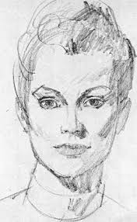
Ice Breaker
Notes:
Ice breaker activity. Please pair up and draw your partner, without looking at the piece of paper in front of you. Here is one I did last week!
2 mins – paper and pencils / pen needed.

Slide 6
Notes:
Resilience isn't about never falling down, its about getting back up again, in your own time, and being kind to yourself and others to do so.
Resilience is the ability to survive and thrive under difficult conditions, for example, if a child is sitting alone in the play ground, can they be resilient enough to find a friend/group of children to play with?
Some say its being able to BOUNCE BACK from the difficult things or times in life, this could include, peer pressure, losing a pet, friendship issues and/or traumatic experience’s.
Resilient people continue to develop to their own potential even when circumstances are against them.
Resilience develops all of the time and is achieved through meeting challenges successfully.
Vulnerability and resilience can change. One day you may be feeling resilient and able to deal with any difficult things that day brings. Other days, for example if you have a cold or a headache, you may be feeling less resilient.
Resilience is always at this moment in time, i.e. how resilient do you feel today, at this time, right now.
Resilience is different from just coping.

Slide 7
1 in 10 children and young people will be affected by mental health issues.
Notes:
Despite so many children needing support, only 1 in 4 young people with a mental disorder reported accessing specialist mental health services in the previous year.
Children and young people were much more likely to have accessed
informal support sources (such as online support, or from their friends and family) or
other forms of professional support (e.g. teachers or primary care professionals).
Family and social support also had an association with mental health disorders. Rates of disorder were higher for children whose parents had a mental health problem, or who received disability-related income, and for children whose families had the lowest levels of functioning.
This was particularly pronounced for very young children (aged 2-4). 14.9% of children whose parents had poor mental health had a disorder themselves by the age of 4.
Children with a disorder were less likely to participate in school-based or other external clubs (e.g. afterschool clubs, sports, arts, music or drama clubs) and were more likely to report low levels of social support, and smaller social networks.
These figures illustrate how mental health disorders can occur from early childhood, and that their prevalence increases with age, particularly for young women.
This highlights the importance of intervening early to prevent the development of mental health problems.
The factors associated with mental health disorders in these statistics point toward environmental and social influences that can act as important risk and protective factors for young people’s mental health.
Capitalising on opportunities to provide children with supportive environments early is key to ensure good mental health for all children and young people.

Slide 8
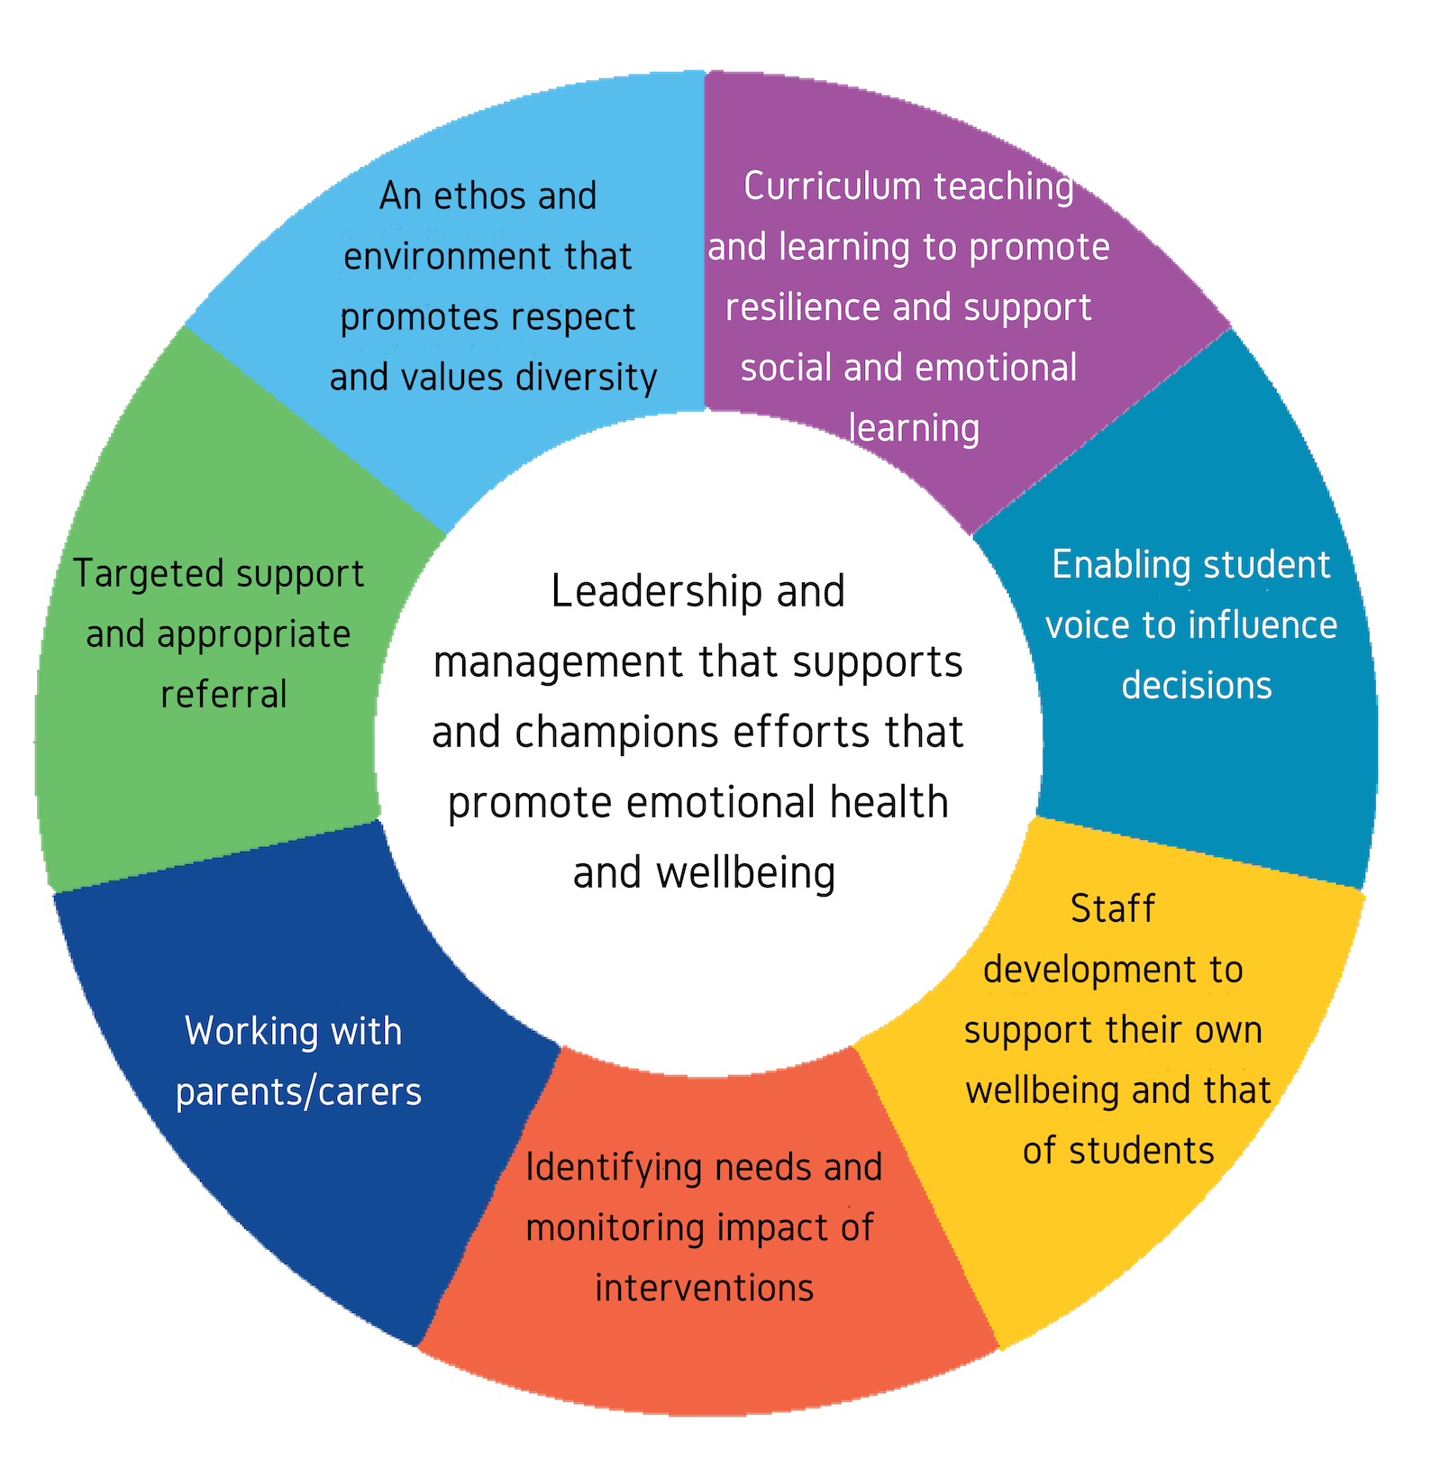
What is a Whole School Approach?
Public Health England (2015) “Promoting Children and Young People’s Emotional Wellbeing: A Whole School and College Approach.”
Notes:
Introduce WSA with the following quotes / info:
“A whole school approach is cohesive, collective and collaborative action in and by a school community that has been strategically constructed to improve student learning, behaviour and wellbeing, and the conditions that support these.”
“A whole-school approach involves all parts of the school working together and being committed. It needs partnership working between governors, senior leaders, teachers and all school staff, as well as parents, carers and the wider community.”
It is widely recognised that a child’s emotional health and wellbeing influences their cognitive development and learning as well as their physical and social health and their mental wellbeing in adulthood so supporting schools, as a setting, to promote emotional health and wellbeing as part of their every day work creates a sound foundation for success.
Can also use the below to reference:
The National Institute for Health and Care Excellence (NICE) advises that primary schools and secondary schools should be supported to adopt a comprehensive, ‘whole school’ approach to promoting the social and emotional wellbeing of children and young people.
Such an approach moves beyond learning and teaching to pervade all aspects of the life of a school, and has been found to be effective in bringing about and sustaining health benefits. A simple way to think about this its not just what C&YPs learn but how they learn it and the experience of the whole school day.

Slide 9
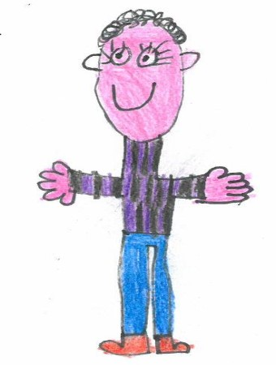
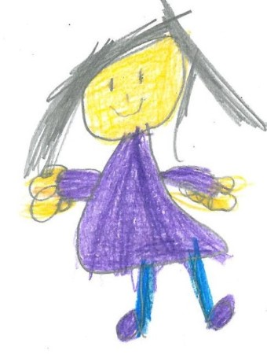
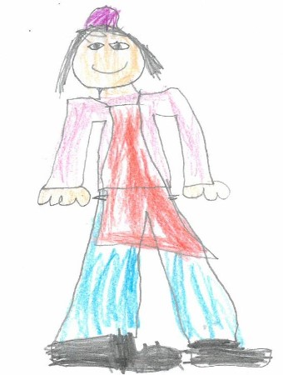
A Whole School Approach means everyone who is part of your school community:
Whole school policies and practices that promote positive wellbeing.
Training and CPD for staff.
The school culture, ethos and environment.
Teaching, learning and the curriculum.
Partnerships with parents, families and the wider school community.
Notes:
A whole-school approach is about developing a positive ethos and culture – where everyone feels that they belong.
It involves working with families and making sure that the whole school community is welcoming, inclusive and respectful.
It means maximising children’s learning through promoting good emotional health and wellbeing across the school – through the curriculum, early support for pupils, staff-pupil relationships, leadership and a commitment from everybody.
Adopting a whole-school approach to mental health and wellbeing is a process, not a one-off activity.
To describe a school as ‘Resilient and emotionally healthy’ involves assessment, planning and ongoing evaluation.
The Whole School approach is designed to have population level impact.

Slide 10
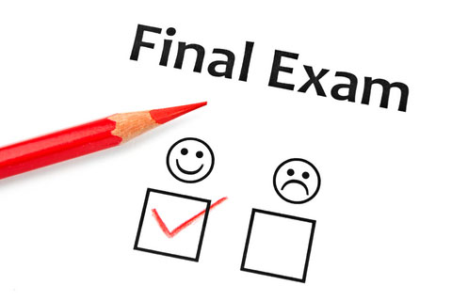
Benefits of a Whole School Approach
Government policy (NICE, 2015; Public Health England, 2015) and empirical research demonstrates that a Whole-School Approach can lead to improvements in the school culture, staff wellbeing, pupil behaviour, school attendance and academic attainment (Weare, 2015; Banerjee et al., 2014).
Critically, a Whole-School Approach fosters a school culture which holds the wellbeing of the entire school community at its forefront.
Notes:
Government policy (NICE, 2015; Public Health England, 2015) and empirical research demonstrates that a Whole-School Approach can lead to improvements in the school culture, staff wellbeing, pupil behaviour, school attendance and academic attainment (Weare, 2015; Banerjee et al., 2014).
A Whole-School Approach enhances the emotional health of all children and young people. Not only is this vital as both a preventative approach, and to optimise life chances for all pupils (Goodman et al., 2015), but it also creates a positive, supportive environment in which to cultivate those with identified difficulties.
Critically, a Whole-School Approach fosters a school culture which holds the wellbeing of the entire school community at its forefront.
Public Health England, (2015) state that “The physical, social and emotional environment in which staff and students spend a high proportion of every week day has been shown to affect their physical, emotional and mental health and wellbeing, as well as impacting on attainment.”

Slide 11
Links between a WSA and the Ofsted 2019 framework
“The curriculum and the provider’s wider work support learners to develop their character – including their resilience, confidence and independence –and help them know how to keep physically and mentally healthy.”
A curriculum which extends beyond the academic, technical or vocational.
A positive environment with a culture of anti-bullying and respect.
Shared values, policies and practice at a Senior Leadership Level.
Notes:
There are clear links to a whole-school approach in the most recent Ofsted education inspection framework (in use from May 2019).
This is a direct quote from the framework: “The curriculum and the provider’s wider work support learners to develop their character – including their resilience, confidence and independence –and help them know how to keep physically and mentally healthy.”
Other areas referenced within the new framework include:
A curriculum which extends beyond the academic, technical or vocational.
A positive environment with a culture of anti-bullying and respect
Shared values, policies and practice at a Senior Leadership Level.

Slide 12
Whole School Approach In Action
Activity: in your groups, match the Whole-School Approach principles to the examples of practice.
Notes:
Activity – match the WSA principles to examples of practice
Can your staff match them?
Activity
Print slides, double sided so numbers are on back, ask staff to match green statements, elements of the whole School approach, to the yellow statements, every day good practice.

Slide 13
Principle | Examples of Practice
1. Leadership and Management | Specific Wellbeing Coordinator role appointed with leadership responsibilities Resilience Team in place (inc Wellbeing Coordinator, SLT, Assistant Head, Early Help Coordinator, Senior FLO), which feeds into agenda for weekly student team meetings Membership of countywide school Mental Health Network Chair of the Ashford HeadStart Local Delivery Leadership Team meeting (community of practice) Mental Health and Wellbeing Policy developed and Mental Health and Emotional Wellbeing given strong emphasis within School Improvement Plan Strong alternative curriculum options offered HeadStart action plan in place and regularly reviewed and appointed School and Parent Governor for wellbeing
2. Teaching, Learning and Curriculum | Established PSHRE programme for all students, with designated coordinator, focusing on resilience, mental health, wellbeing and social skills Extensive sports clubs offered across the school day and beyond Targeted mindfulness sessions and farm/agriculture schooling for students Staff trained for working with Children in Care affected by trauma Spiritual, moral, social and cultural development required within all lessons Staff work with students to enhance the curriculum and challenge mental health stigma
3. Enabling Student Voice | SpeakOut (Student Voice / Wellbeing group) established and meets weekly Young Evaluators trained and wellbeing evaluation projects underway Groups of students successful in securing grants and leading wellbeing projects within HeadStart’s Pay It Forward scheme 6th Form Cabinet meet regularly and feed back to Director of Student Leadership All students completed student self-assessment - Feedback is regularly gathered and analysed to monitor the effectiveness of emotional wellbeing support and identify improvements Active Youth Health Champions group in place to lead student health campaigns
4. Staff Development | All staff have received training on the HeadStart programme, the importance of a whole school approach to resilience and wellbeing, and tools available to use to support students Youth Mental Health First Aid, Building Resilience, and Mindfulness training completed by key staff Tailored CPD included within staff performance review and staff survey carried out and results acted upon Termly staff wellbeing sessions provided (including focus on mindfulness, yoga, cross country walking, 6 ways to wellbeing, stress management, Chinese 5 elements and youth health) Occupational Health counselling support available for staff ‘Made a Difference’ / Outstanding Achievement awards for staff Learning from HeadStart LDLT Mental Health Network is shared through staff meetings

Slide 14
Principle | Examples of Practice
5. Identify Need and Monitoring Impact of Interventions | Changes in behaviour reported by staff, students, or peers and robust safeguarding teams and procedures in place Resilience Conversation and Self-Reflection tools are used between students and staff to gain an overview of students’ needs and strengths Interventions spreadsheet developed for monitoring and Early Intervention Officer in place Staff Designated Safeguarding Leads members of DSL Ashford district meetings A trusted adult is assigned to every student and resilience programme is delivered at form time Peer mentors trained and available for students Personalised reintegration programme established for school refusers
6. Working with Parents and Carers | Opportunities for wellbeing discussions at parents’ evenings and information evenings held for parents, e.g. on exam stress and how best to support your child Parent governor position with wellbeing insight on board of governors Parent section on school website developed to signpost to support and guidance and parent app developed for updates Active school Twitter account used to communicate with parents/carers and the wider community School policies and information available on school website or over the phone / via email / meetings
7. Targeted Support and Appropriate Referral | Staff have extensive local knowledge of wellbeing services covering the catchment area of students attending the school and refer, when appropriate Intensive mentoring and volunteer mentoring accessed through HeadStart and Kooth online support and counselling promoted to individuals Talents and Interest grants accessed for students Specialist LGBTQ+ support sought from The BeYou Project (Porchlight/NHS) Regular meetings for students with external agency support Year 8-9 college transition support meetings Tailored support plans are put in place for students with long term mental health conditions Collaboration with Education Engagement Officer for targeted work for students within Gypsy Roma and Traveller communities Liaison with KCC for students no longer on role and home educated Safe spaces are provided within school for meetings with external agencies, students, parents, staff.
8. Ethos and Environment | Reference to ethos of openness in School Improvement Plan Display boards and assemblies demonstrate culture of speaking about emotions, difference and resilience, including in school reception area Mental Health and Wellbeing policy developed and on school website and Mental health, diversity and respect included in PSHRE curriculum Inclusive school motto is embedded - ‘learning, respect, belonging’ for all and assemblies celebrate diversity frequently across the school year Anti-bullying policy is in place and procedures are known by students, staff and parents Year 7-8 Anti-Bullying Ambassadors support this ethos, particularly in Anti-Bullying week Safe spaces across school – Young Evaluators have been trained to evaluate these Staff wellbeing/CPD sessions focus on resilience Many links and projects exist between the school and the wider community, including primary schools, local community groups and parents

Slide 15
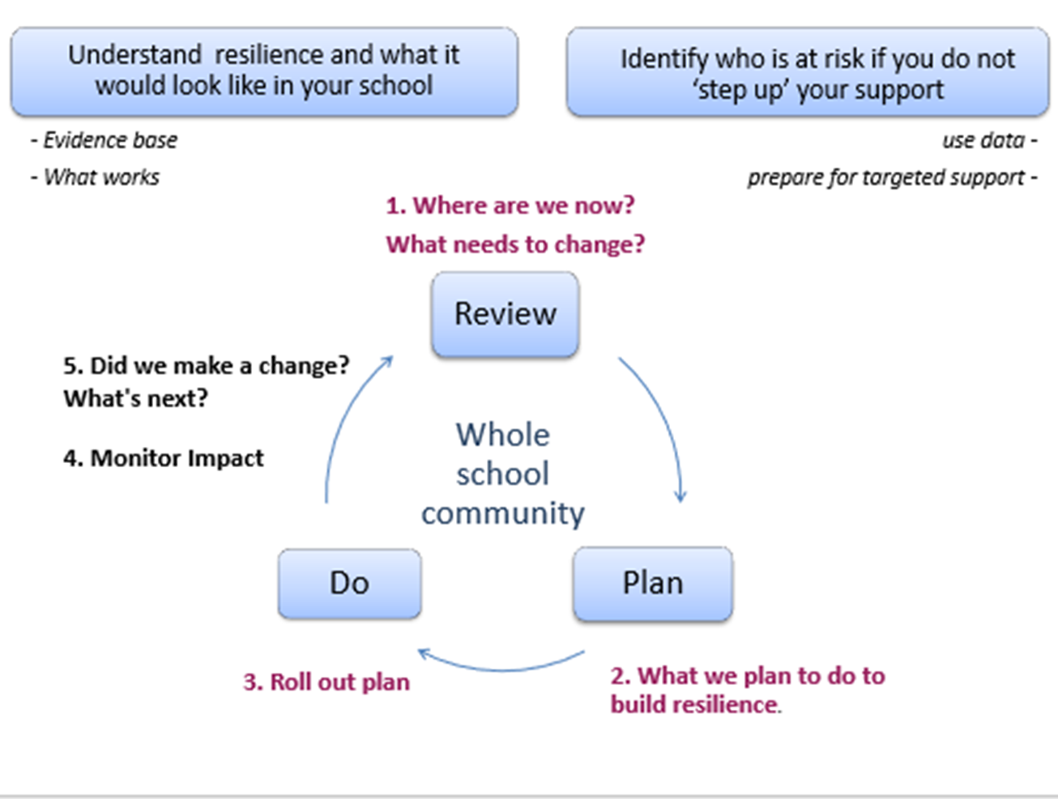
Next Steps for a Whole School Approach
Notes:
NON HEADSTART SCHOOL SLIDE
Use the Kent Resilience Toolkit to support you in considering your setting’s approach to resilience and wellbeing through a whole-school approach
“Assess” stage: what are we already doing well? What would be even better if?
“Planning” stage: what can we put in place to develop our approach to resilience and wellbeing? Use the HeadStart Hub and resources to support you in implementing these actions.
“Review”: What has worked well, what has the impact been? What needs changing? Next steps?
At the end of this process your setting can apply for the Kent Award (Quality Mark) to recognise your hard work and commitment to resilience and wellbeing.

Slide 16
Next Steps for a Whole School Approach
Do any of the principles of a Whole-School Approach need prioritising within your setting?
Is this recorded within your Resilience and Emotional Wellbeing Record (action plan)?
Who will support this, what skills/knowledge do you have to draw upon, and when will this happen?
Notes:
HEADSTART SCHOOL SLIDE – THIS IS BESPOKE DEPENDING ON THE SCHOOL – LINK IN WITH THE SCHOOL LEAD AND PROGRESS MADE WITH THE TOOLKIT SO FAR.
ASK THE HSK LEAD WHAT THEY WOULD LIKE TO FOCUS ON OR INCLUDE DURING THIS SECTION, DOES THE HSK LEAD WANT TO PRESENT? SHOULD THE ACTION PLAN BE INCLUDED?
CAN THE HSK LEAD PROVIDE EXAMPLES OF WHAT THEY HAVE PUT IN PLACE OR DEVELOPED ALREADY BASED ON EACH OF THE PH 8 PRINCIPLES?
Resilience Team and Action Plan (Resilience and Emotional Wellbeing Record)
What are the next steps for your school?
Could they attend other training?

Slide 17
Whole School Approach – further reading
Promoting children and young people’s emotional health and wellbeing: A whole school and college approach (Public Health England, 2015)
How does poor mental health in the early years of secondary school impact on GCSE attainment? (NatCen Social Research 2019)
Mentally Healthy Schools
Guardian article on staff wellbeing
Young Minds resources on staff wellbeing
Schools Week tips on staff wellbeing
Anna Freud Centre staff wellbeing booklet
HeadStart Kent website

Slide 18
Staff Wellbeing
Notes:
School staff are the leaders in developing a whole school approach.
Staff need to look after their own wellbeing in order to support those around us (other staff, families, young people). We cannot pour from an empty cup.
This session is for STAFF WELLBEING and them to think about their own wellbeing. Resources/ideas etc can be used with their families, own lives, or even in the classroom but this part of the session is for them.

Slide 19
What is wellbeing?
• Feel confident in yourself
• Feel and express a range of emotions
• Feel engaged with the world around you
• Live and work productively
• Cope with the stresses of daily life and manage times of change and uncertainty.
If you have good mental wellbeing (or good mental health), you are able to:
Notes:
Ask the group what they think wellbeing is and allow discussion.
Resources-
Flip chart/ pens/ post-its on tables
Ask the heading and question (orange half) ask them to work with their pair they have just done the ice breaker with and note down some suggestions to feedback to the group.
Allow a couple of minutes and ask for contributions, and then clarify with writing on slide.

Slide 20
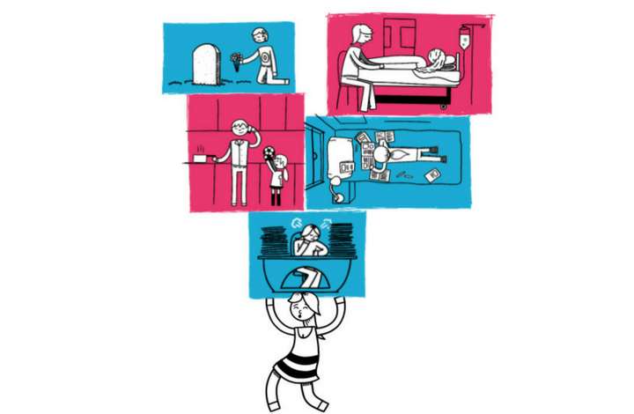
What can impact our wellbeing?
We all have times when we feel sad or stressed, or find it difficult to cope. For example:
If we suffer some sort of loss
Times of change i.e. moving school, moving house
Feeling isolated/alone
Experience friendship/relationship problems
Worry about school, work or money.
Notes:
Resources
Flip chart/ pens/ post-its on tables
Ask the heading and question (purple half) ask them to work with their pair they have just done the ice breaker with and note down some suggestions to feedback to the group.
Allow a couple of minutes and ask for contributions
Follow up with the blue writing on the slide to clarify.

Slide 21
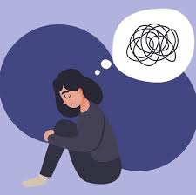
Anxiety
Notes:
Resources
Flip chart/pens/ flip chart
How do we feel anxiety? What happens to our body?
Draw on the contributions from the group
Ask the group is anxiety normal?
Next slide

Slide 22
Is anxiety normal?
YES!
Anxiety is a normal response to stress or danger and is often called the ‘flight or fight’ response.
This process involves adrenalin being quickly pumped through the body enabling it to cope with whatever catastrophe may come its way.
Anxiety only becomes problematic when our ‘anxious/stressed out’ response is out of proportion, if it continues even after the event that we found stressful is over, or if it is stopping us from doing day to day things.
Notes:
Anxiety is the feeling of fear or panic. Most people feel anxious, panicky or
fearful about situations in life, such as money problems or exams but often once
the difficult situation is over, you feel better and calmer. Sometimes the feelings
of fear or anxiety continue after the difficult situation or sometimes you may feel
a stronger sense of fear than other people and this is when anxiety becomes a
problem and can affect you doing every day things.
Feeling anxious about exams, starting a new job or doing something new is all normal, it only becomes a problem when it continues after the event.

Slide 23
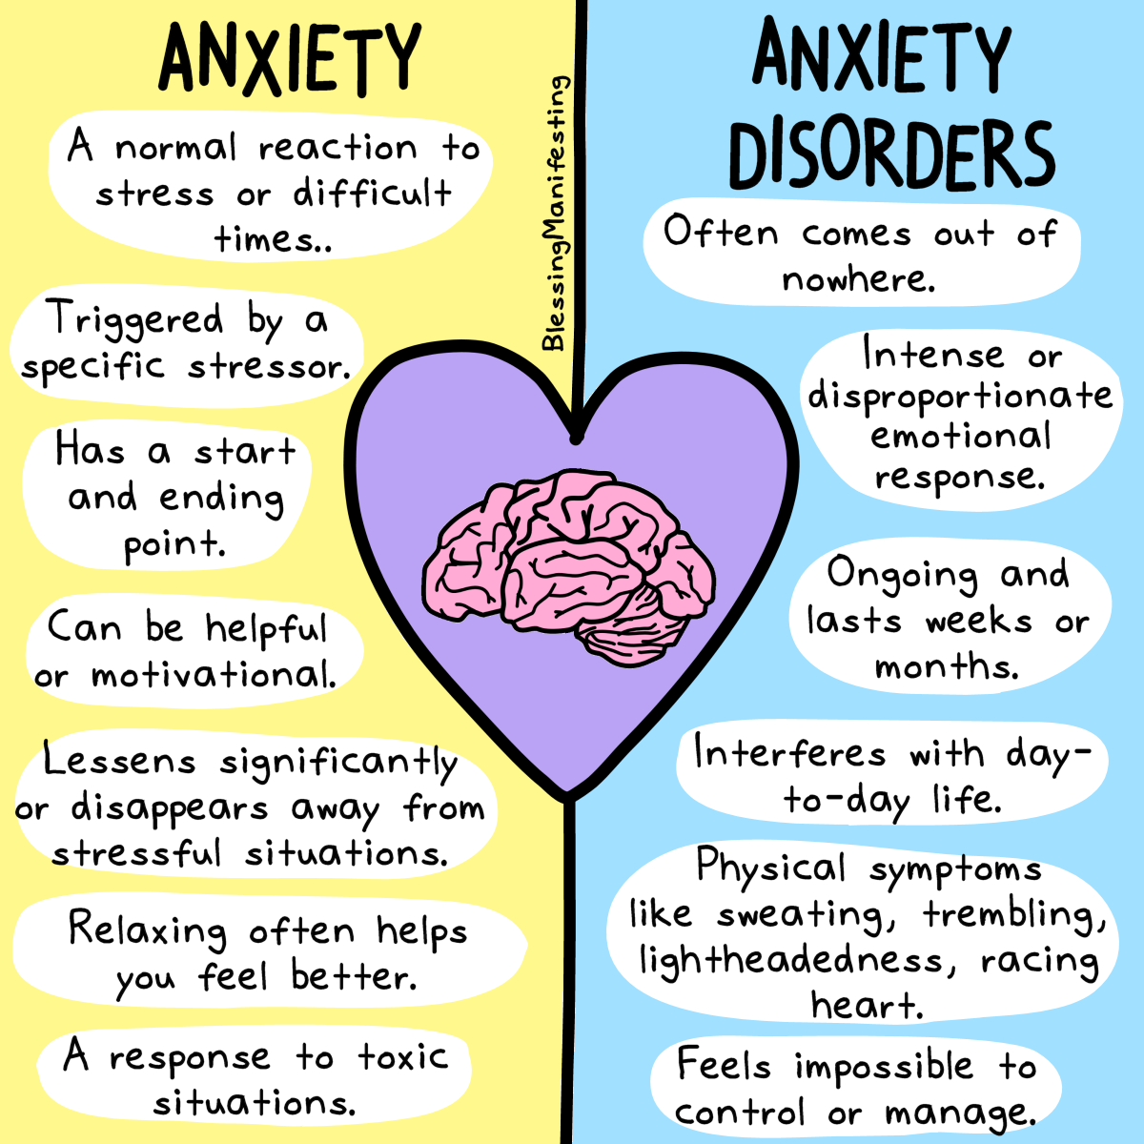

Slide 24
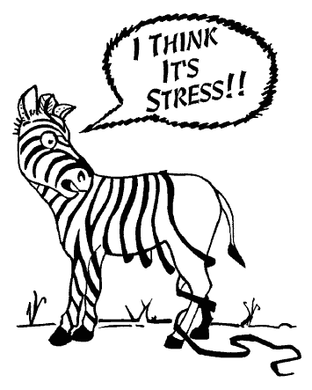
Dealing with anxiety and stress
What signs might you notice when your
stress levels rise?
What might other people notice?
What can others do to help you if they notice or you tell them you are stressed?
What can you do to help yourself?
Notes:
Resources-
Flip chart with each heading on a sheet of paper/ blue tac/ pens
Ask the group to think about these statements and contribute in small groups, 4 groups is usual but you could have x2 groups doing the same sheet, so 8 groups working on 4 statements. These can then be read out if time allows or just pin them to the wall for the group to see whilst doing other activities.

Slide 25
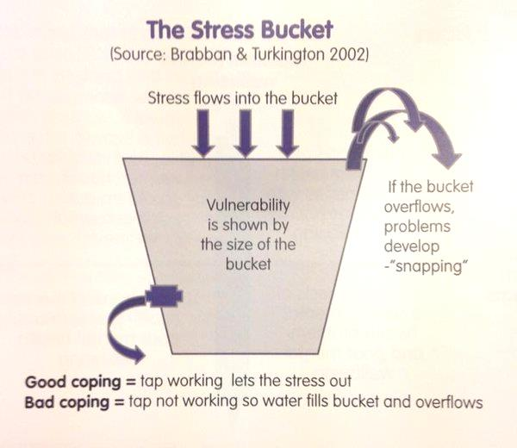
Stress Bucket Activity
What sorts of things fill up stress buckets?
What are good ways to cope and let the stress out (the tap)?
Notes:
Resources-
Flip chart with stress bucket drawn on
This is the stress bucket, every one has a stress bucket, some peoples are small, others are large (hold hands in front of stomach to suggest small or large stress bucket in the body).
Stresses come into the stress bucket like rain water filling up a bucket. Here is the normal level (for water) and here is the relaxed level (for water) this is ideally where we would like it to be. (refer to your drawing of the stress bucket).
What sort of things are going to fill up our stress bucket? Ask for contributions and write them on flip chart (like rain water coming in to the bucket).
We all have many stresses and strains that can fill up our stress bucket so its important that we release the water pressure with these holes at the bottom of the bucket.
Everyone release holes are completely unique to them and it is a good idea to think about what these are and have your ‘go to’ activity/activities ready for when you feeling stressed or low as its often in these times we can’t remember what we need to do to look after ourselves to feel better.
Next slide-

Slide 26
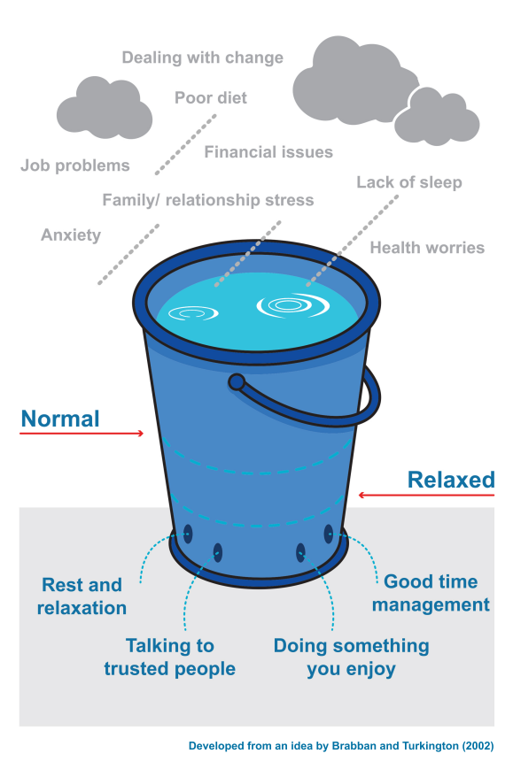
Stress Bucket Activity
Notes:
Feedback – what were the group’s suggestions of things that can fill up stress buckets?
Examples may include the image, as well as:
Negative self-talk
Overworked / lack of self-care
Lack of exercise
Feeling isolated
Conflict
Deadlines
Feeling let down
Conflicting priorities
Good ways to cope include:
Rest – self care
Connecting with people – quality time with loved ones and friends
Asking for help
Enough sleep
Finding ways to switch off
Get out and about / exercise

Slide 27
Washing Line Activity
Notes:
Resources-
String, pegs, sharpie mini pens, 6 ways to wellbeing type statements (diamond 7 attached)
In a moment I want you to go to the table at the back and pick or write on one of the statement cards an activity that you can use to de-stress and unwind. All of the statements are linked to the 6 ways to wellbeing which we are going to discuss in a moment, but if you cant see anything you like there you can tailor your own with the pens available. Once you have chosen your statement please hang it on the washing line.
Lead trainer then reads out the statement washing line to clarify what participants will be doing to release the pressure in their stress bucket. Clarify that the stress bucket is a great way to help parents/carers understand about stress and how it is important to reduce it via an outlet, you could even link this to a talents and interests grant!

Slide 28
Six Ways to Wellbeing
Notes:
https://livewellkent.org.uk/six-ways-wellbeing/
Resources-
6 ways connect activity
6 ways give activity
6 ways keep learning activity
6 ways take notice activity
Has anyone heard of or use 6 ways?
Play link for background to six ways
Use attached resource activities for ideally 7 minutes per group, smaller groups are better than larger groups for this as otherwise particularly the connect activity does not have the same impact. If catering for a large group consider replicating the activities and having more than one group doing the same activity, with separate resources. Groups of 5 are ideal.

Slide 29
Six Ways to Wellbeing
1. Be Active… Go for a walk or run. Step outside. Cycle. Play a game. Garden. Dance. Exercising makes you feel good. Most importantly, discover a physical activity that you enjoy; one that suits your level of mobility and fitness.
2. Keep Learning … Try something new. Rediscover an old interest. Sign up for that course. Fix a bike. Learn to play an instrument or how to cook your favourite food. Set a challenge you will enjoy achieving. Learning new things will make you more confident, as well as being fun to do.
3. Give … Do something nice for a friend, or a stranger. Thank someone. Smile. Volunteer your time. Join a community group. Look out, as well as in. Seeing yourself, and your happiness, linked to the wider community can be incredibly rewarding and will create connections with the people around you.
4. Connect … With the people around you. With family, friends, colleagues and neighbours. At home, work, school or in your local community. Think of these as the cornerstones of your life and invest time in developing them. Building these connections will support and enrich you every day.
5. Take Notice … Be curious. Catch sight of the beautiful. Remark on the unusual. Notice the changing seasons. Savour the moment, whether you are on a train, eating lunch or talking to friends. Be aware of the world around you and what you are feeling. Reflecting on your experiences will help you appreciate what matters to you.
6. Care For The Planet … look after your community and the world. Make small changes to your life that will reduce your energy use, recycle more, leave the car at home, use low energy light bulbs, small steps to a greener life can make a difference.
Notes:
Some Schools do one way per term, we have only tried 4 ways today but the website has more. 6 ways sessions are great to use in the classroom with pupils, for staff meetings to support wellbeing or at parent/carer events as a simple way to engage your School community around emotional health an wellbeing.
Be Active - beanbag/juggling ball balancing & movement, balloon keepie uppies (I will try to copy the little blurb I have about this), wake & shake, playground game e.g what's the time Mr Wolf, dancing to a song, doing a mini assault course, C4L activity wheel
Keep Learning - make some play doh/ make a model from play doh of something you like to do (and talk about what it is), make an origami 'snapper' and add kind thoughts to it
Connect
Memory bag to prompt children to share their good memories – in my bag currently I have:
- A teddy bear – what is their favourite toy (for teacher workshops maybe what was their favourite childhood toy)
- A postcard – where was the last place they went on holiday
- A book – what is their favourite story?
- A tube map – have they been to London and if so, what did they see?
- A picture of a dog/cat – do they have a family pet and if so, what is the best thing about them e.g. soft fur, going for a walk, having a cuddle etc
- A film dvd and/or an old cinema ticket – what film do they like and what did they last see at the cinema?
- A bauble from the Christmas tree – what do they do as a family at Christmas that is special?
- A picture of a football club – who do they support and/or what sport do they like to watch?
Give (share) – any of the following:
- Draw a tree on a piece of flipchart paper – ask children to write or draw on a post-it note what they do to help them to relax, and talk about why it helps
- Hang up a ‘washing line’ – give the children a small piece of card or paper and ask them to draw or write one positive thing that has happened today or one kind thought that they would like to share with others – then hand the thoughts on the line and talk about the responses
- Make a play-doh model of something they enjoy (if keep learning activity was to make play-doh).
Take notice
- If it is possible to go outside, take the children out to the playground/field and ask them to take a photograph (they could even take an imaginary photo using their hands to make a frame) of something that they think is beautiful.
- Provide some paper, big leaves collected from outside, crayons – let the children create some leaf rubbings to reflect the outside environment and then display as a collage
- Carry out the ‘take notice’ activity – ‘5 things’ – learning about the senses: sight, hearing, touch, smell, taste.
Care for the Planet
- Make some ‘mini bug hotels’ out of cardboard tubes, straws and string, then hang them outside to create a bug-friendly environment
- Ask the children to think about projects that they do at school which help take care of the planet e.g. collecting rubbish on a ‘womble’ walk, eco-schools, reducing food waste at lunch time etc

Slide 30
General tips for wellbeing
Eat right - eat fresh fruit and veg and have a proper breakfasts. Fuel your brain as well as your body - no one can think straight on coffee and chocolate.
Sleep well - wind down before bed and don't revise/work under the duvet - your bed is a sanctuary, not a desk. Get your eight hours.
Exercise - nothing de-stresses the mind faster than physical activity, so build it into your timetable.
Notes:
Tips for wellbeing:
Eat right - eat fresh fruit and veg and have a proper breakfasts. Fuel your brain as well as your body - no one can think straight on coffee and chocolate.
Sleep well - wind down before bed and don't revise/work under the duvet - your bed is a sanctuary, not a desk. Get your eight hours.
Exercise - nothing de-stresses the mind faster than physical activity, so build it into your timetable.

Slide 31
Useful websites
Anna Freud Self Care
Tips on some of the things everybody can do for their wellbeing and mental health.
https://www.annafreud.org/on-my-mind/self-care/
AnxietyUK
AnxietyUK run helplines, email support, live chats and therapy services for people with anxiety
disorders.
http://www.anxietyuk.org.uk/
www.anxietyuk.org.uk/about-anxiety/young-people-and-anxiety/exam-stress-and-anxiety
C.A.L.M
C.A.L.M (campaign against living miserably) is a charity dedicated to preventing male suicide. They have lots of information on their website and run a helpline from five to midnight.
http://www.thecalmzone.net/
Live It Well
http://www.liveitwell.org.uk/
Mind
Mind offers information and wellbeing tips, alongside advice and support to people with mental health problems. Their helpline runs nine to six from Monday to Friday.
http://www.mind.org.uk/
Notes:
Alongside our HeadStart website, other Useful websites:
Anna Freud Self Care
Tips on some of the things everybody can do for their wellbeing and mental health.
https://www.annafreud.org/on-my-mind/self-care/
AnxietyUK
AnxietyUK run helplines, email support, live chats and therapy services for people with anxiety
disorders.
http://www.anxietyuk.org.uk/
www.anxietyuk.org.uk/about-anxiety/young-people-and-anxiety/exam-stress-and-anxiety
C.A.L.M
C.A.L.M (campaign against living miserably) is a charity dedicated to preventing male suicide. They have lots of information on their website and run a helpline from five to midnight.
http://www.thecalmzone.net/
Mind
Mind offers advice and support to people with mental health problems. Their helpline runs nine to six from Monday to Friday.
http://www.mind.org.uk/
Live It Well
http://www.liveitwell.org.uk/

Slide 32
Questions?
Notes:
Does anyone have any questions?

Slide 33
Contact Info
Name:
Role:
Contact info:
@HeadStartKent www.kentresiliencehub.org.uk HeadStart@kent.gov.uk
Notes:
If you would like any further information or wish to contact us, here are the details.

